Slide 1

On Magnetohydrodynamic(MHD) boundary layer flow of nanofluids past a porous flat plate
By
Winifred Mutuku-Njane
(Email: winnieronnie1@yahoo.com)
July 2012
Co-Author: Prof O.D. Makinde

Slide 2
Presentation Overview
Abstract
Definition of key words
Applications of MHD and nanofluids
Literature review
Mathematical Formulation
Incompressible Nanofluids
Dimesnionless Governing Equations
Results and Discussion
Conclusion
References

Slide 3
Abstract
The problem of magnetohydrodynamic boundary layer flow of nanofluids past a semi- infinite porous flat plate is investigated.
Water base nanofluids containing Copper (Cu) and Alumina (Al₂O₃) are used.
The governing nonlinear differential equations are obtained and solved numerically using the 4th order Runge-Kutta method with shooting technique taking into consideration the complex interaction between the electrical conductivity of the conventional base fluids and that of the nanoparticles.
The entire flow regime is investigated to establish the influence of pertinent parameters such as Hartmann number (Ha), Suction Parameter (S), nanoparticle volume fraction(ϕ) and Brinkmann number(Br) on velocity, temperature, skin friction and Nusselt number.
The obtained results are presented graphically and the physical aspects of the problem discussed quantitatively.

Slide 4
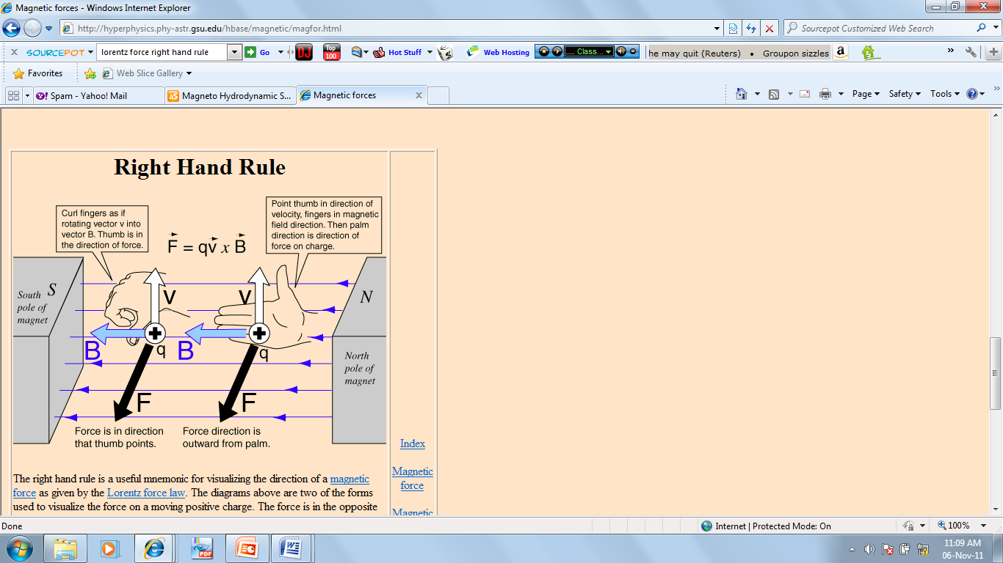
What is MHD ?
Magnetohydrodynamics (MHD) is the study of the flow of electrically conducting fluids in a magnetic field.
MHD is derived from three words; magneto – magnetic field, hydro –fluids, and dynamics –movement.
The term MHD was initiated by Alfvén (1908-1995).
It covers phenomena where electrically conducting fluids, with velocity field V, and the magnetic field B are coupled.
Any movement of a conducting material in a magnetic field generates electric currents j, which in turn induce
  their own magnetic fields, and
  j x B forces on the medium known as Lorentz force.
Figure 1: The Right Hand Rule

Slide 5
Table 1: Electrically Conducting Fluids
Liquid | σ*, 1/Ohm×m
Weak electrolytes | 10⁻⁴ to 10⁻²
Strong electrolytes Water+25% NaCl (20°C) Pure H₂SO₄ (20°C) | 10¹ to 10² 21.6 73.6
Plasma (10⁴K - 10⁶K) Totally Ionised Gas | 10³ - 10⁶ 10⁷
Liquid metals Mercury (20°C) | 10⁶ to 10⁷ 1.0×10⁶
*σ, electrical conductivity (1/Ohm×m), shows ability of liquid to interact with
a magnetic field

Slide 6
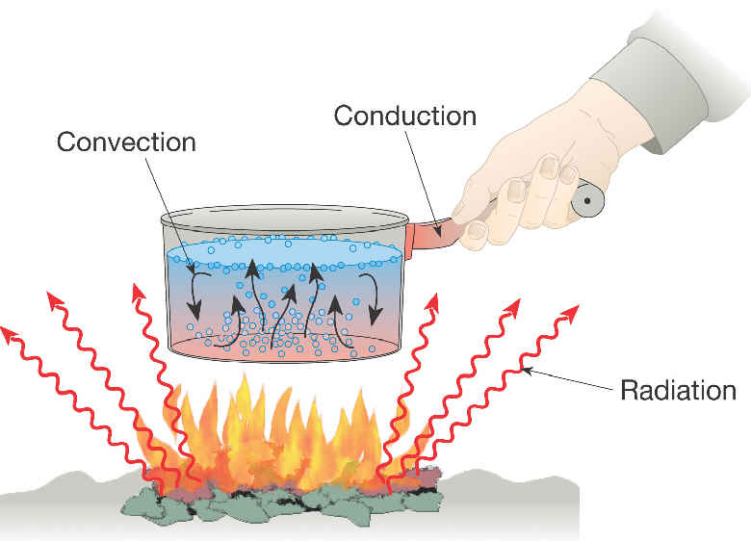
Heat Transfer
Heat transfer is the energy transfer, which takes place between material bodies as a result of temperature difference.
When two bodies are at different temperatures, thermal energy transfers from the one with higher temperature to the one with lower temperature.
There are three modes of heat transfer: conduction, convection and radiation.
The study of heat transfer has many applications in modern technology in areas such as energy production, heat exchangers (which are used in refrigeration, air conditioning, space heating and power generation) , nuclear reactors.
Figure 2: Modes of Heat Transfer

Slide 7
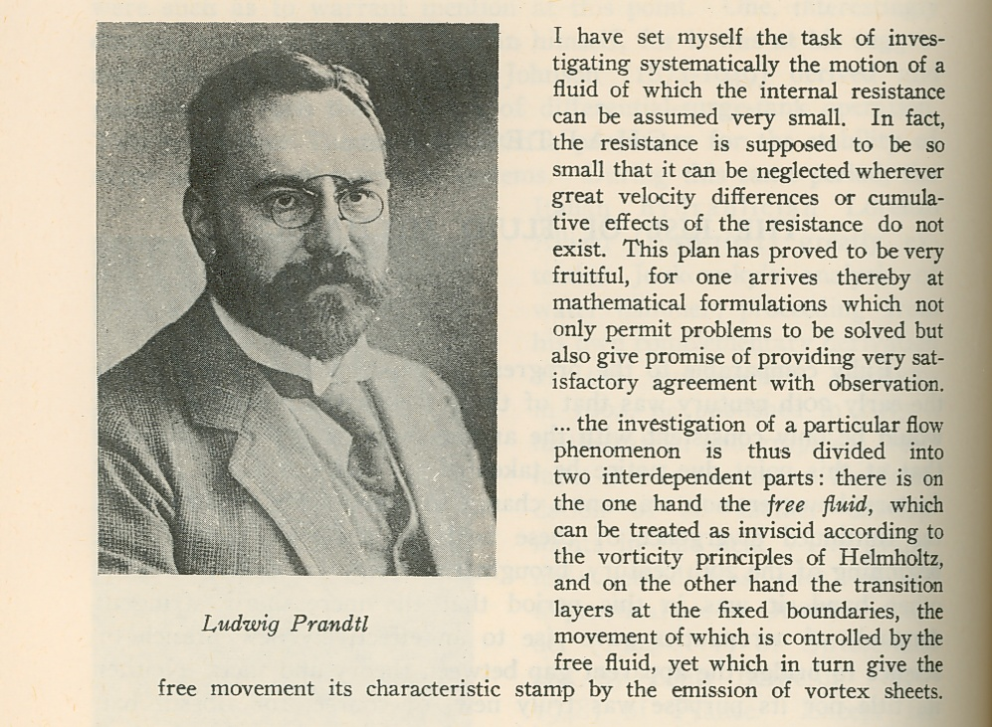
Boundary Layer
The concept of boundary layer in fluid flow over a surface was introduced by Ludwig Prandtl in 1904.[Anderson, 2005]
Due to friction the fluid immediately adjacent to the surface stick to the surface (no- slip condition) and the fluid velocity is zero.
This thin layer adjacent to the surface of a body or a solid wall in which viscous forces affect the flow is called the boundary layer.
The distance from the boundary to the height above the surface at which the velocity becomes 99% of the free stream velocity is called Boundary Layer Thickness.
There are two types of boundary layers; hydrodynamic(velocity) boundary layer and thermal boundary layer.
Figure3: Prandtl’s Article, 1875-1953

Slide 8
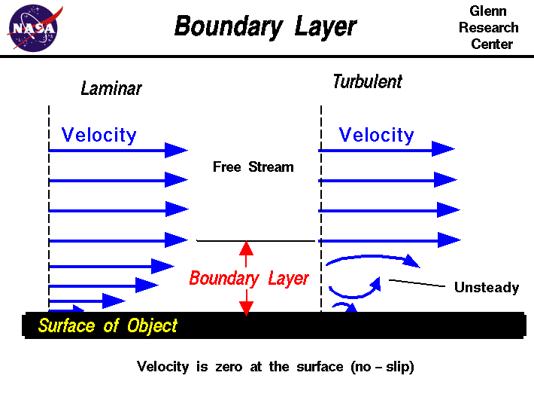
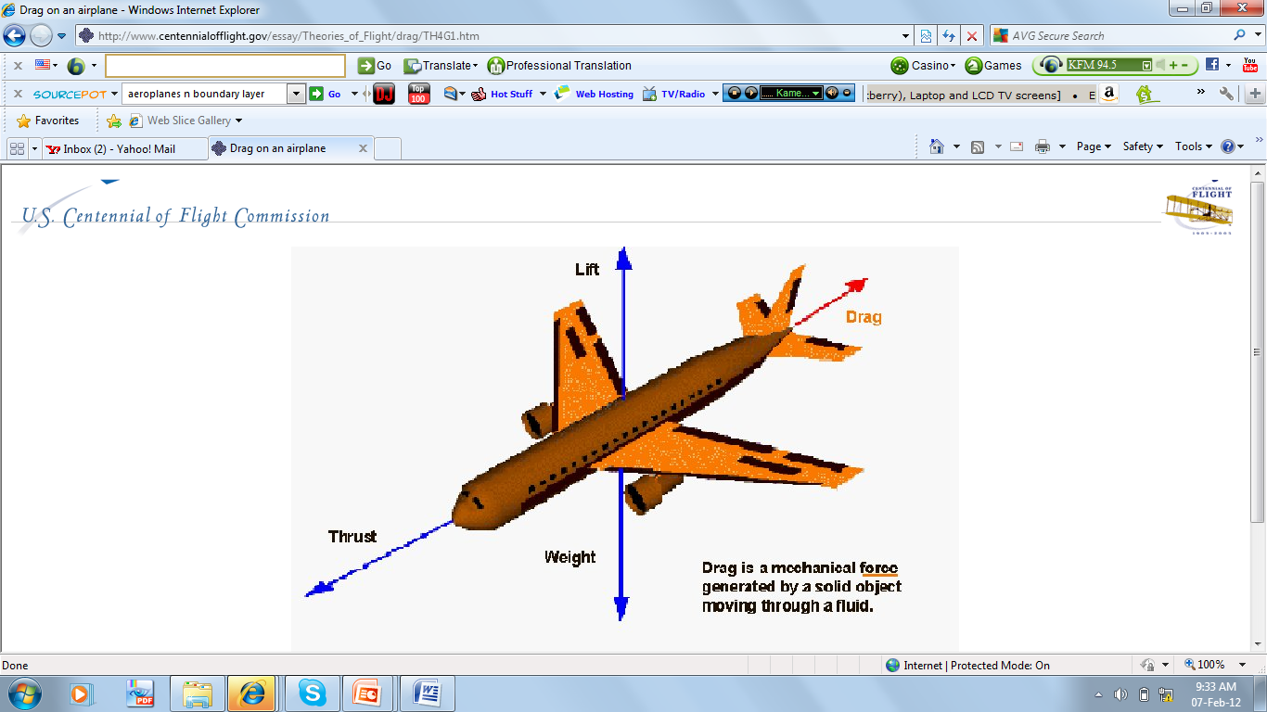
Boundary Layer and Reynolds Number
The thickness of boundary layer is a function of the ratio between inertial forces and viscous forces, ie. the Reynolds number.
At low Reynolds number, the flow is laminar, and for high Reynolds number the flow turbulent.
The concepts of boundary layer in heat transfer plays an important role in the design of most industrial and engineering systems.
In aerodynamics, boundary layer is applied in the calculation of friction drag of bodies in a flow, such as friction drag of a ship and the body of an aeroplane.
Figure4: Boundary Layer
Figure5: Friction Drag

Slide 9
Nanofluids
Nanofluids is the resultant of dispersing small amounts of nanometer-sized (10–50 nm) particles and fibers in base fluids to enhance thermal conductivity.
Heat transfer fluids such as water, minerals oil and ethylene glycol play an important role in many industrial sectors including power generation, air-conditioning, transportation and cooling of microelectronics. But their performance is often limited by their low thermal conductivities.
The term nanofluids was first used by Choi in 1995.
The suspended metallic or nonmetallic nanoparticles change the transport properties and heat transfer characteristics of the base fluid, hence enhance the heat transfer of the base fluid.
Nanofluids have enhanced thermophysical properties such as thermal conductivity, thermal diffusivity, viscosity and convective heat transfer coefficients compared to those of base fluids.

Slide 10
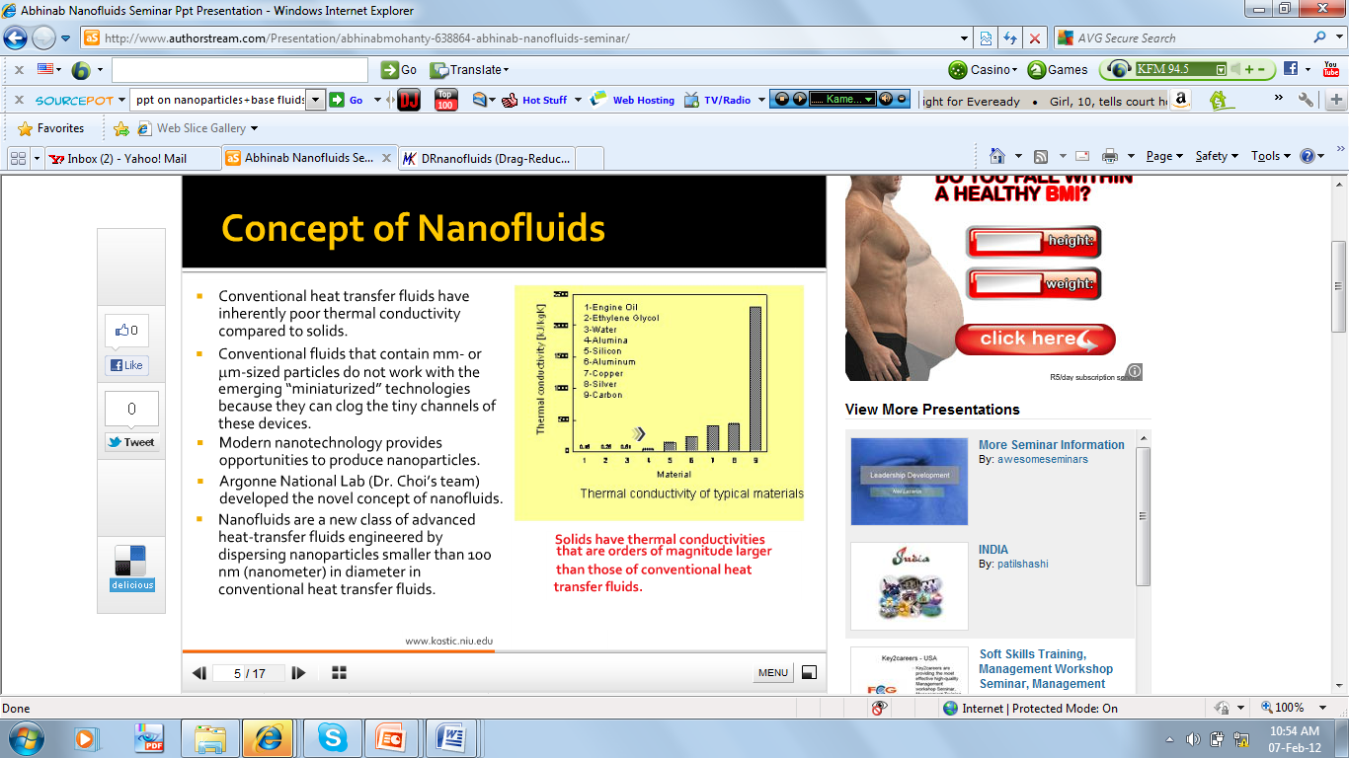
Base Fluids and Nanoparticle
Base Fluids include:
Water
Ethylene or tri-ethylene glycols & other coolants.
Oil & other lubricants
Polymer solutions
Bio-fluids
Other common fluids
Nanoparticle Materials Include:
Oxide ceramics (Al₂O₃,CuO,TiO₂)
Metal carbides (SiC)
Nitrides (AlN, SiN)
Metals (Al, Cu, Ag, Au, Fe)
Nonmetals (graphite, carbon nanotubes)
Layered (Al+ Al₂O₃, Cu+C)
Figure6: Thermal Conductivity of materials

Slide 11
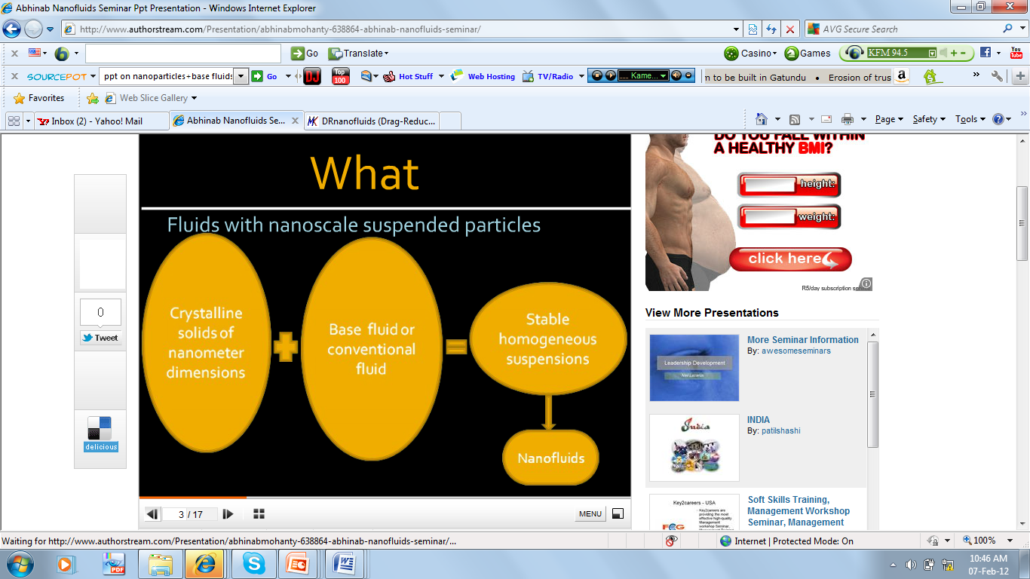
Nanofluids synthesis

Slide 12
MHD applications
Many natural phenomena and engineering problems are susceptible to MHD analysis.
Astrophysics (planetary magnetic field)
Geophysics (stars, galaxies)
MHD pumps (1907)
MHD generators (1923)
MHD flow meters (1935)
Metallurgy (induction furnace and casting of Al and Fe)
Dispersion (granulation) of metals
Ship & space propulsion
Crystal growth
MHD flow control (reduction of turbulent drag)
Magnetic filtration and separation
Jet printers
Nuclear Fusion Reactors and Plasma Confinement(blanket, divertor, limiter, FW)
Magnet Drug Targeting

Slide 13
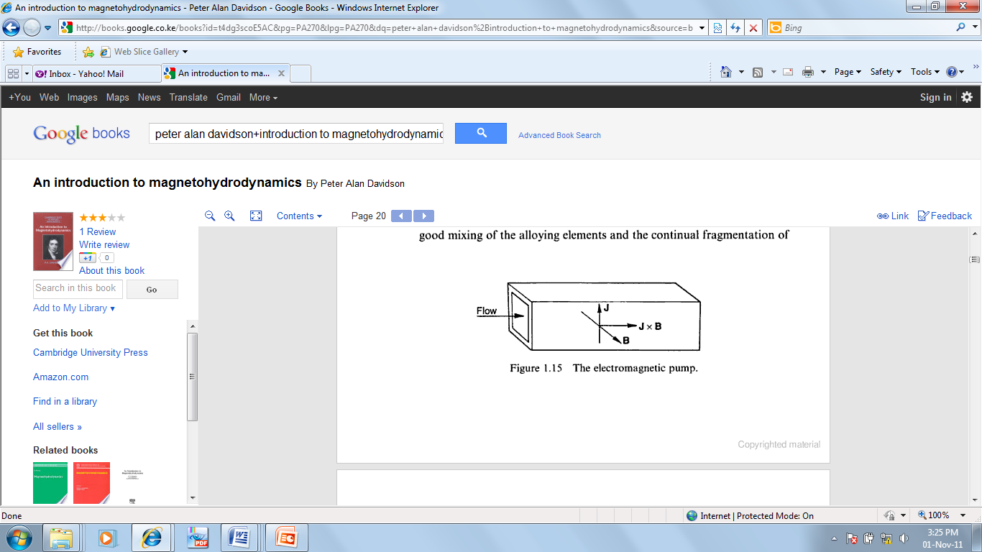
MHD Pump
The first MHD pump was built in 1907 .
The pump consists of mutually perpendicular magnetic and electric fields arranged normally to the axis of a duct. The duct is filled with a conducting liquid. As current flows, the resulting Lorentz force provides the necessary pumping action.
Micropumps are required in chemical, medical, and biological applications such as microsyringes for diabetics since they are able to handle small and precise volumes
Its effective for producing a continuous, nonpulsating flow in a complex microchannel design.
It has several advantages, such as simple fabrication process, and bidirectional pumping ability (direction of the applied current)
Figure11: MHD Pump

Slide 14
MHD Flow Meter
The basic idea is that a conducting fluid flowing through a magnetic field produces an EMF. By measuring an EMF, a flow rate can be determined
It is an electromagnetic flow measurement method that is based on exposing a flow to a magnetic field and measuring the force acting on the magnetic field generating system.
It started in 1832 when Michael Faraday attempted to determine the velocity of the Thames river.
The initial Flow meters required electrodes to be inserted into the fluid for flow measurement, thus were limited to applications at low temperatures, eg, beverages, chemicals and wastewater.m
Current flow meters do not require a direct contact with the fluid, velocity is determined from measurements of flow-induced deformations of the applied field.
MHD has been used to create a flowmeter for blood, to monitor fluctuations in the rate of blood flows in arteries.

Slide 15
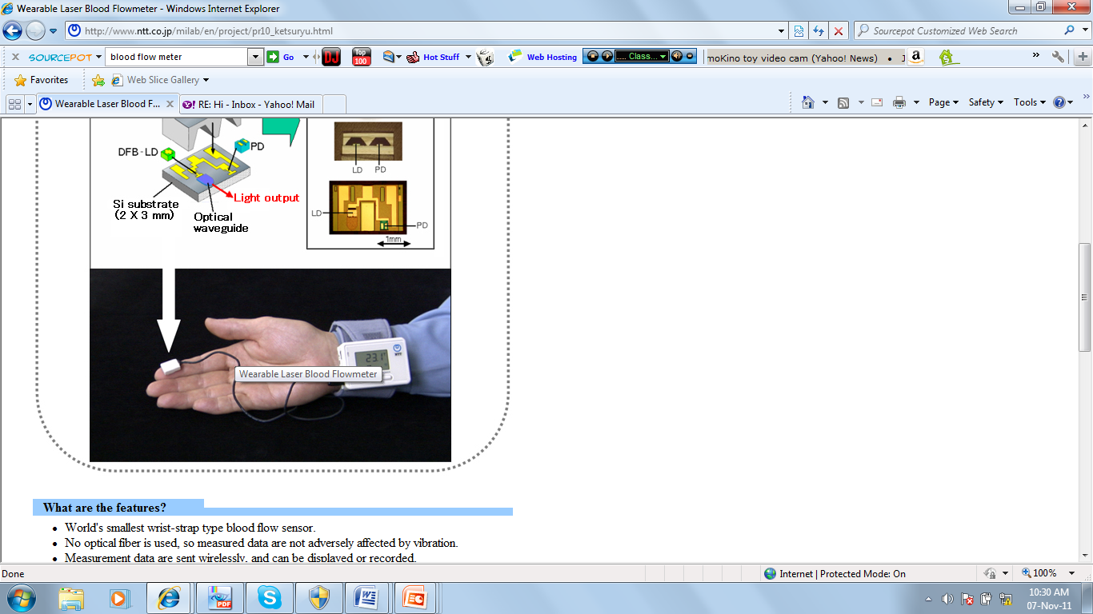
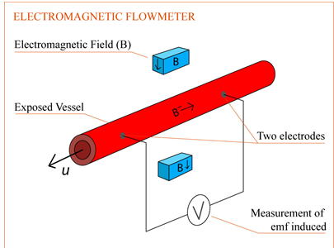
MHD Blood Flow Meter
The use of flow meters to study blood flows was initiated by Kolin(1936).
Two electrodes are attached along the length of a vessel, and an electromagnetic field is applied perpendicular to the flow.
The emf between the two electrodes can be measured and gives a continuous result proportional to the flow velocity.
The blood flowmeter is used during vascular surgery to measure the quantity of blood passing through a vessel or graft, before during or after surgery.
Figure 12: Blood Flow Meter

Slide 16
Nanofluids Applications
Nanofluids potential applications to improve heat transfer and energy efficient in several areas including automobile, micro electronics, nuclear, space and power generation (Raja et al 2010).
Heat Transfer Applications
Industrial Cooling Applications:
Nanofluids for industrial cooling will result in great energy savings and emissions reductions.
For instance, in tyre plants, the productivity of many industrial processes is constrained by the lack of facility to cool the rubber efficiently as it is being processed, and as a result lots of heat transfer fluids are required.
The use of water-based nanofluids can reduce the cost of production of the tyres and result in an increase in profit margins.
Nanoparticles in refrigerant/lubricant mixtures could enable a cost-effective technology for improving the efficiency of chillers that cool large buildings.
Considering that space cooling is responsible for nearly 13 % of total building electric expenditures, significant reductions in building energy consumption and carbon dioxide emissions can be realized with use of nanofluids.

Slide 17
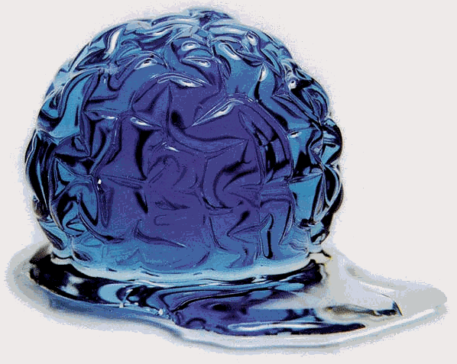
Nanofluids Applications
Heat Transfer Applications
Smart Fluids
In this era of energy saving and the widespread use of battery operated devices, such as cellphones and laptops, have accented the necessity for a smart technological handling of energetic resources.
Smart materials have one or more properties that can be dramatically altered, eg, smart material with variable viscosity may turn from a fluid which flows easily to a solid.
Nanofluids can be used as a smart material working as a heat valve to control the flow of heat, where heat transfer can be reduced or enhanced at will.
Figure 14: A smart fluid developed in labs at the Michigan Institute of Technology [2001 SMA/MEMS Research Group ]

Slide 18
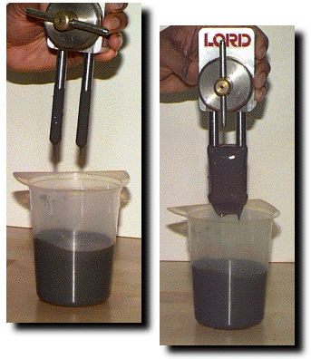
Smart Fluid
Smart Fluids
Magneto-rheostatic (MR) materials are fluids, which consists of tiny iron particles suspended in oil.
These fluids can change from a thick fluid (similar to motor oil) to nearly a solid substance within the span of a millisecond when exposed to a magnetic field, the effect is completely reversed when the field is removed.
MR fluids are being developed for use in car shocks, damping washing machine vibration, prosthetic limbs, exercise equipment, and surface polishing of machine parts.
Figure 15: The MR fluid is liquid on the left, and as a solid in a magnetic field on the right[2001 SMA/MEMS Research Group ]

Slide 19
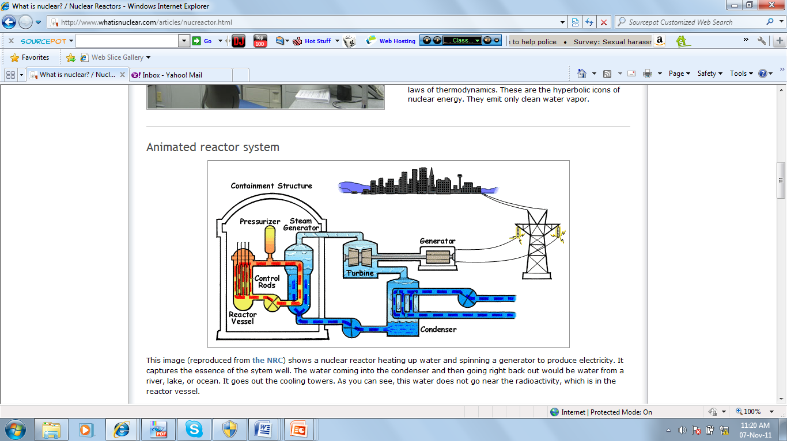
Nuclear Reactor
A nuclear reactor is a system that contains and controls sustained nuclear chain reactions.
Reactors are used for generating electricity, moving aircraft carriers and submarines, producing medical isotopes for imaging and cancer treatment, and for conducting research.
Fuel with heavy atoms are placed in a reactor vessel with neutrons. The neutrons start a chain reaction where each atom splits releasing more neutrons that cause other atoms to split. This produces large amounts of energy in form of heat.
The heat is carried to coolants, which heat up and go off to a turbine to spin a generator, thus producing electricity.
This provided clean energy alternative that frees us from the shackles of fossil fuel dependence.
Nanofluids can be used as a coolant in Nuclear Reactors
Figure 16: Nuclear Reactor Plant

Slide 20
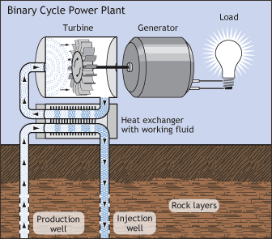
Nanofluids Applications
Heat Transfer Applications
Geothermal Power Extraction
When extracting energy from the earth’s crust (5-10km deep) and temperature (500ºC -1000ºC), nanofluids can be employed to cool the pipes exposed to such high temperatures.
When drilling, nanofluids can serve in cooling the machinery and equipment working in high friction and high temperature environment.
Figure 17: Binary Cycle Power Plant

Slide 21
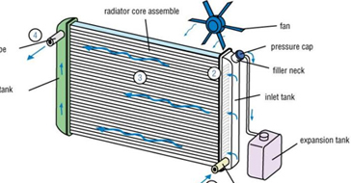
Nanofluids Applications
Automotive Applications
Nanofluid Coolant:
Nanofluids are been used in automobile for applications such as coolant, fuel additives, lubricant, shock absorber and refrigerant.
Nanofluids’ high thermal conductivity can be utilized in engine oils, automaticn transmission fluids, coolants, lubricants.
Use of nanofluids as coolants would allow for smaller size and better positioning of the radiators, hence less energy for over coming resistance on the road, this implies that fuel is saved.
Ford and GM have been doing research on nanofluids for vehicle fluids such as coolants and engine oil.
Figure 18: Car Radiator

Slide 22
Nanofluids Applications
Automotive Applications
Nanofluid in Fuel:
The combustion of diesel fuel mixed with aluminum nanofluid increased the total combustion heat while decreasing the concentration of smoke and nitrous oxide in the exhaust emission from the diesel engine.
Nanolubricants
Extend engine life 2 fold
Reduce oil consumption by
5-10%.
Figure 19: Nanofluids use in Cars

Slide 23
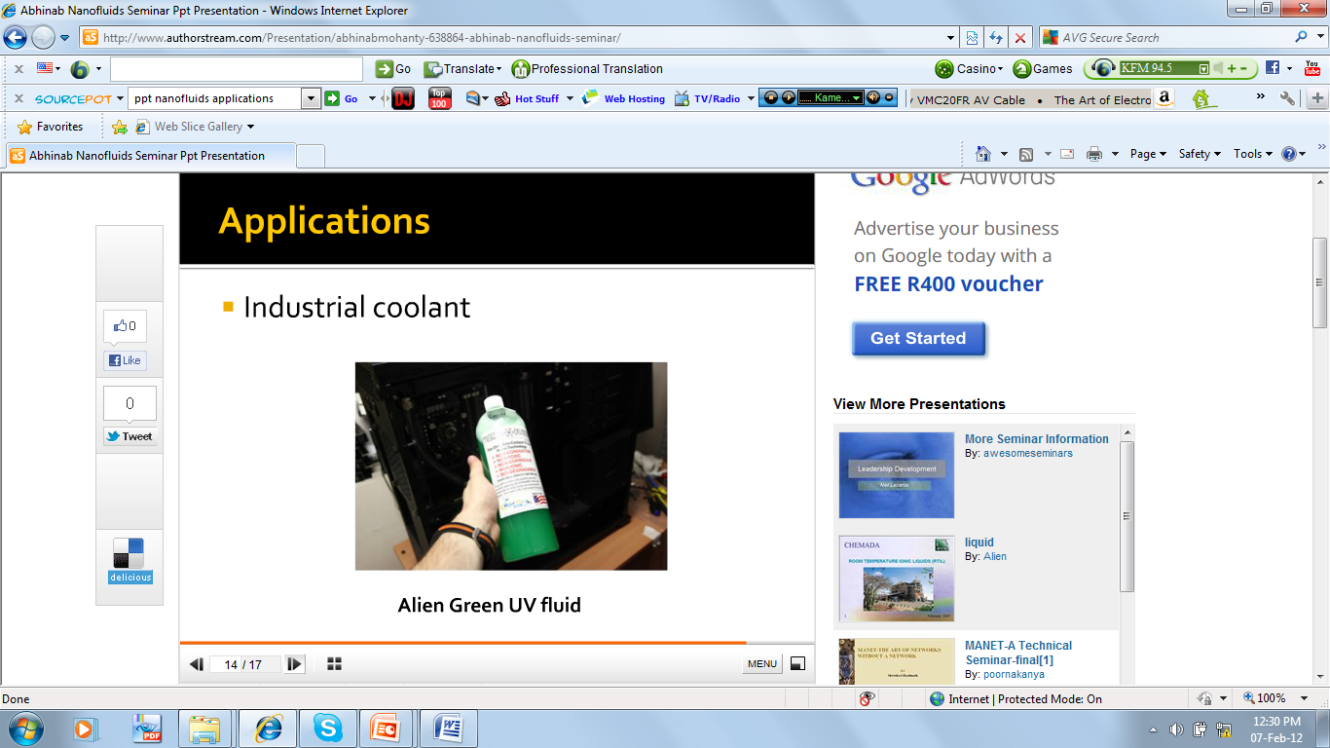
Nanofluids Applications
Automotive Applications
Brake and Other Vehicular Nanofluids.
As vehicle aerodynamics is improved and drag forces are reduced, there is a higher demand for braking systems with higher and more efficient heat dissipation mechanisms and properties such as brake nanofluid.
If the heat causes the brake fluid to reach its boiling point, a vapor-lock is created that retards the hydraulic system from dispersing the heat caused from braking.
Such an occurrence will in turn will cause a brake malfunction and pose a safety hazard in vehicles.
Since brake oil is easily affected by the heat generated from braking, nanofluids will maximize performance in heat transfer as well as remove any safety concerns.
Figure 20: Brake Fluid

Slide 24

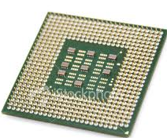
Nanofluids Applications
Electronic Applications
Nanofluids are used for cooling of microchips in computers as well as in other electronic applications which use microfluidic applications.
Cooling of Microchips: Smaller microchips require rapid heat dissipation. Nanofluids can be used for liquid cooling of computer processors due to their high thermal conductivity.
Figure 21: Computer Microchip
Figure 22: Laptop

Slide 25
Nanofluids Applications
Biomedical Applications
Magnetic Drug Targeting
During chemotherapy failure to provide localized drug targeting, results in an increase of toxic effects on neighboring organs and tissues.
This precise targeting is accomplished magnetic drug delivery.
Medicine is bound to magnetic particles (ferrofluids) which are biologically compatible and injected into the blood stream.
The targeted areas are subjected to an external magnetic field that is able to reduce the flow rate of blood stream. The drug is then slowly released from the magnetic carriers.
This reduced the large amounts of the freely circulating drug, at the same time, drug concentrations at the targeted site will be significantly higher compared to the ones delivered by standard delivery methods.
Interactions between the magnetic particles passing through the blood with the external magnetic field are studied using MHD equations and Finite Element analysis. Thus efficacy of such treatments can be estimated.

Slide 26
Literature Review
Since the pioneering work of Hartmann and Lazarus(1937) on the hydromagnetic flow of a viscous electrically conducting liquid, several authors (Singh et al. 1996, Jha 2001, Makinde 2009, Ibrahim and Makinde 2010)have investigated the problem under different flow conditions.
An innovative technique of developing advanced heat transfer liquids with higher conductivities involves dispersing small amounts of nanometer-sized (10–50 nm) particles in base fluids, resulting into what is commonly known as nanofluids, a term introduced in 1995 by Choi.
Several theoretical and experimental results have shown that nanofluids possess enhanced thermophysical properties such as thermal conductivity, thermal diffusivity, viscosity and convective heat transfer coefficients as compared to those of conventional base fluids (Lee and Choi 1999, Eastmann 2001, Makinde and Aziz 2001, Tiwari 2007, Ahmad and Das 2011).
Most of the conventional base fluids used for producing nanofluids are liquids, whose electrical conductivity properties are lower than those of nanoparticles made of metallic or nonmetallic materials.
Therefore, nanofluids possess enhanced electrical conductivity property and are more susceptible to the influence of magnetic field than the conventional base fluids.
Recently, Hamad [14] and Ghasemi et al. [15] investigated numerically the natural convection of nanofluids under the influence of a magnetic field.
Their theoretical studies relied on the assumption that both the nanoparticles and the conventional base fluids have equal electrical conductivity properties which is not the case.
The main objective of this paper is to examine the effects of thecomplex interaction between the different electrical conductivity of the conventional base fluids and that of the nanoparticles on the hydromagnetic boundary layer flow over a flat porous surface.

Slide 27
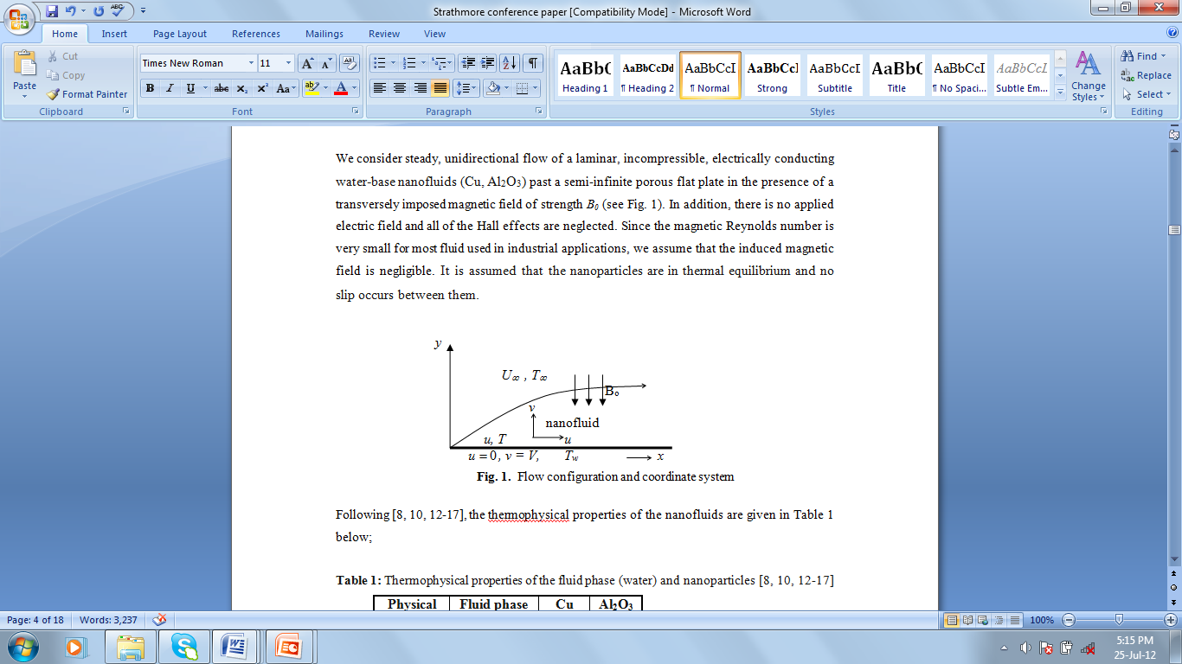
Mathematical Formulation
We consider steady, unidirectional flow of a laminar, incompressible, electrically conducting water-base nanofluids (Cu, Al₂O₃) past a semi-infinite porous flat plate in the presence of a transversely imposed magnetic field of strength B₀

Slide 28
Incompressible Nanofluids
MHD Equations
Continuity
(1)
Navier-Stokes equations with the Lorentz force
(2)
Energy equation with the Joule heating
(3)
Ampere’s law
(4)
(5)
Faraday’s law
Ohm’s law
(6)

Slide 29
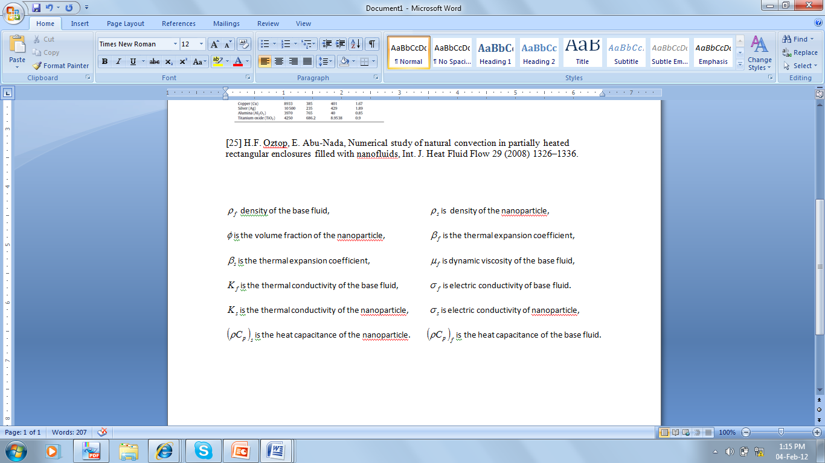
Where,

Slide 30
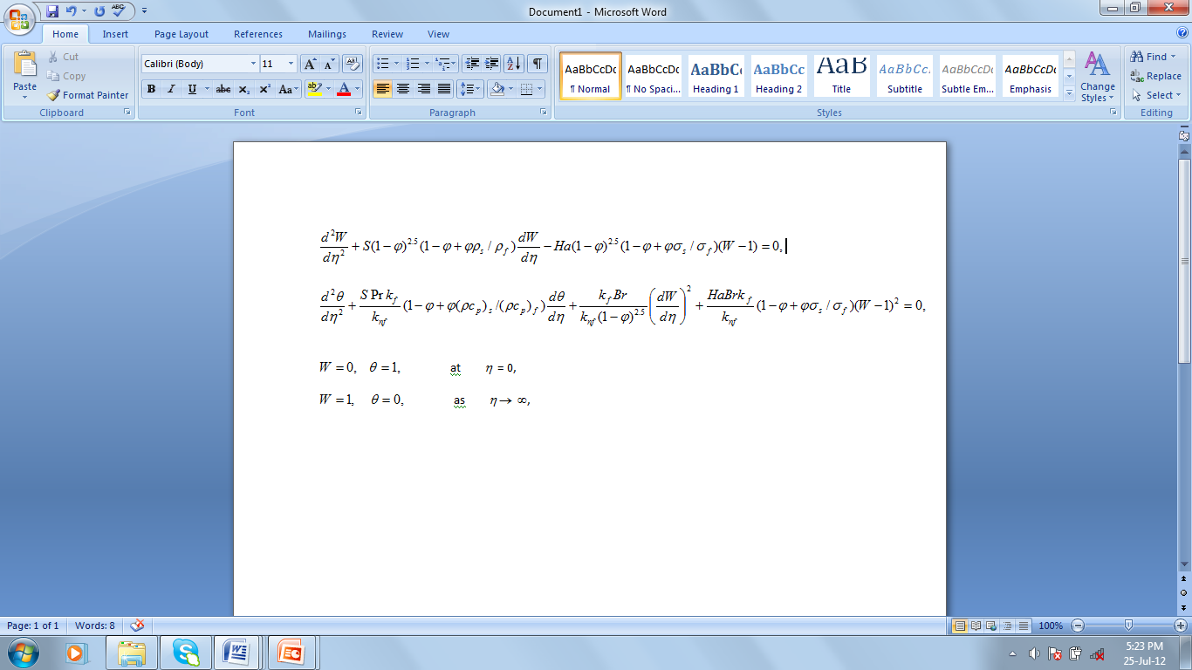
Dimensionless Governing Equations
Under the boundary-layer approximations, the dimensionless nanofluid equations for momentum and energy are:

Slide 31
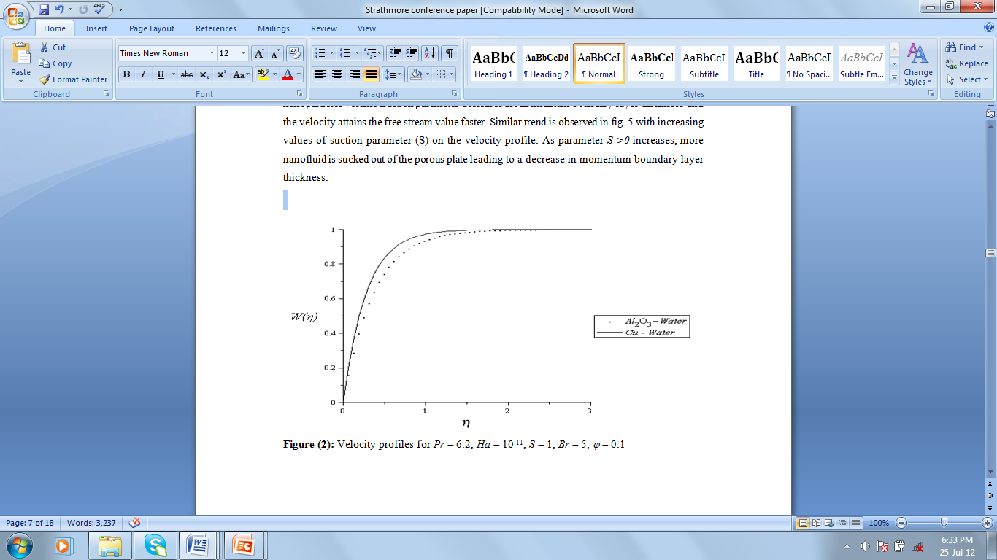
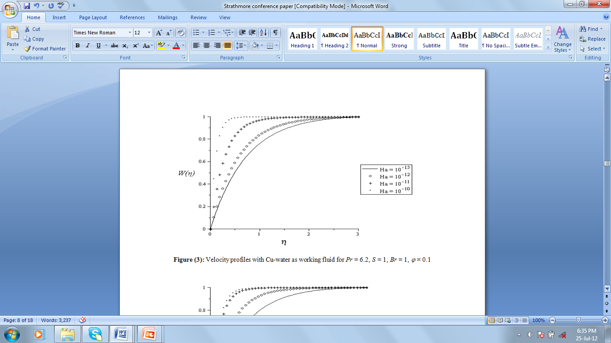
Results and Discussions
Velocity Profiles
Velocity profiles for Pr = 6.2, Ha = 10⁻¹¹, S = 1, Br = 5, ϕ = 0.1
Velocity profiles with Cu-water as working fluid for Pr = 6.2, S = 1,
Br = 1, ϕ = 0.1
Physically, magnetic field together acts as a retarding force. This retarding force can control the nanofluids velocity which is useful in numerous applications such as magneto-hydrodynamic power generation and electromagnetic coating of wires and metal, etc.

Slide 32
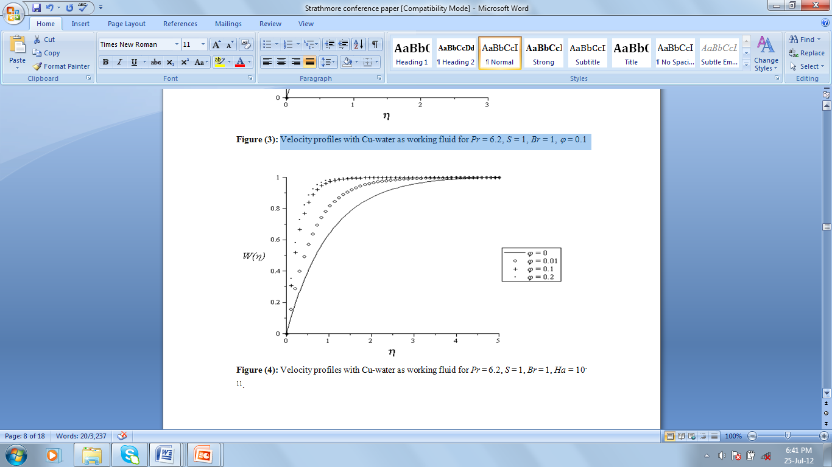
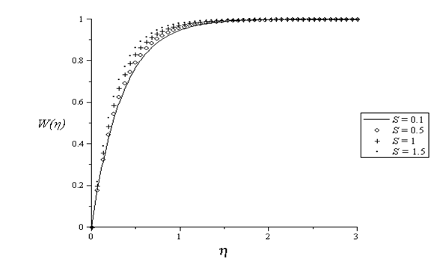
Results and Discussions
Velocity profiles with Cu-water as working fluid for Pr = 6.2,
S = 1, Br = 1, Ha = 10⁻¹¹.
Velocity profiles with Cu-water as working fluid for Pr = 6.2,
Br = 1, Ha = 10⁻¹¹, ϕ = 0.1
As parameter S >0 increases, more nanofluid is sucked out of the porous plate leading to a decrease in momentum boundary layer thickness.

Slide 33
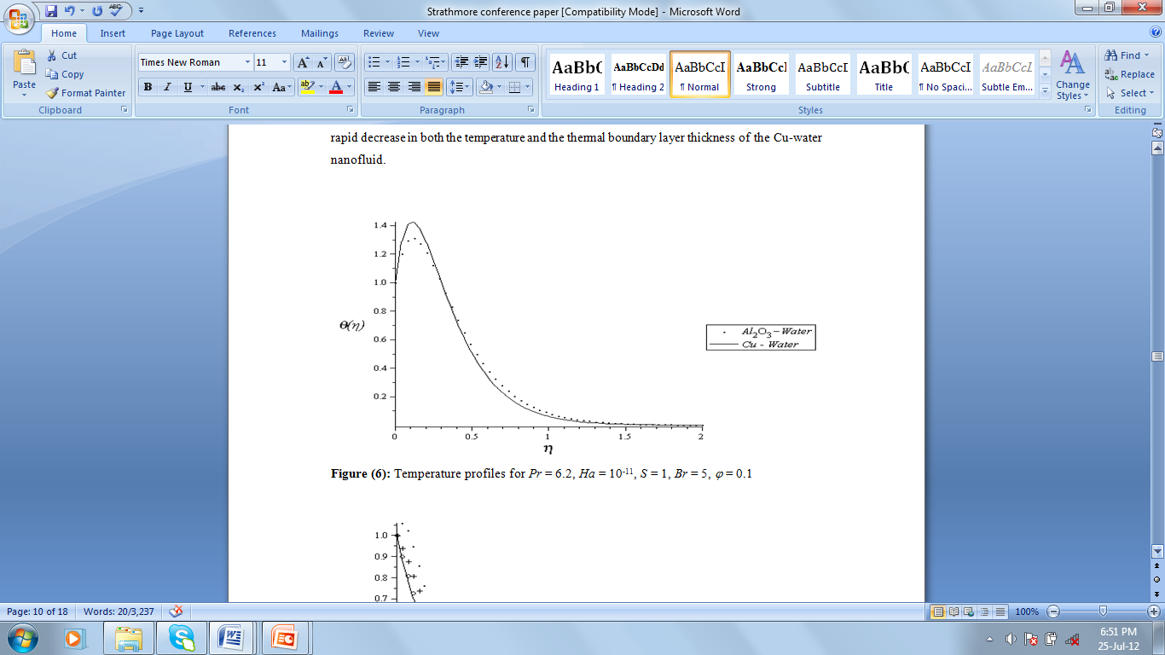
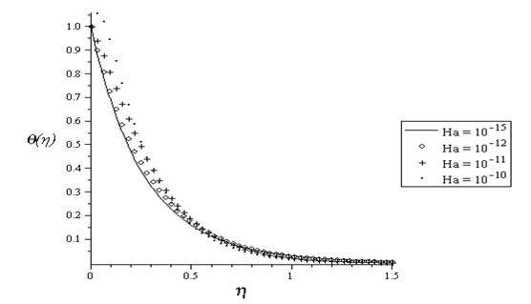
Results and Discussions
Temperature Profiles
Temperature profiles for Pr = 6.2, Ha = 10⁻¹¹, S = 1,
Br = 5, ϕ = 0.1
Temperature profiles with Cu-water as working fluid for Pr = 6.2, S = 1, Br = 1, ϕ = 0.1

Slide 34
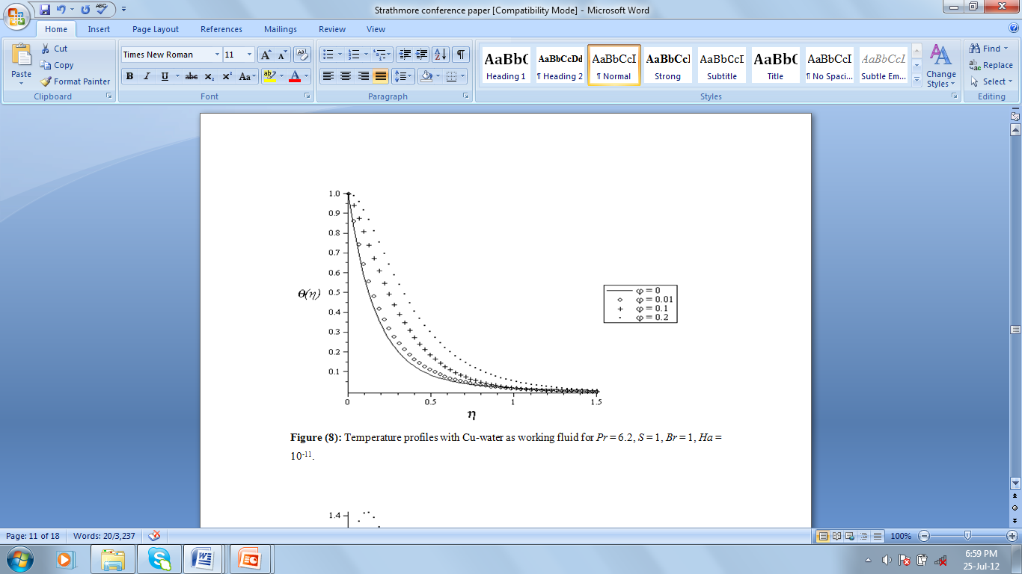
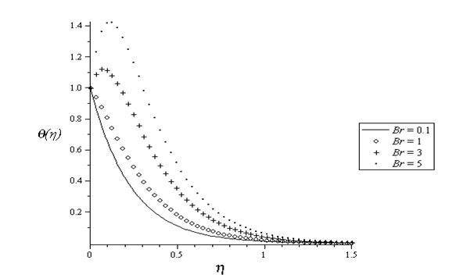
Results and Discussions
Temperature profiles with Cu-water as working fluid for Pr = 6.2, S = 1, Br = 1, Ha = 10⁻¹¹
Temperature profiles with Cu-water as working fluid for Pr = 6.2, S = 1, Ha = 10⁻¹¹, ϕ = 0.1
This observation is in agreement with the expectation in that when the volume fraction of copper increases the thermal conductivity increases, leading to an increase in the thermal boundary layer. Also as the Brinkmann number increases, addition heat due to fluid friction in the flow system increases leading to an increase in the nanofluid temperature.

Slide 35
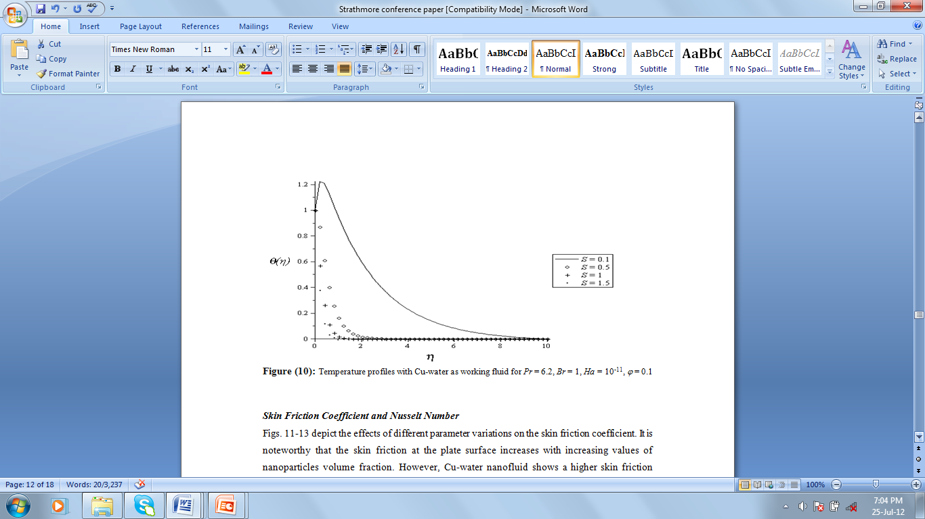
Results and Discussions
Temperature profiles with Cu-water as working fluid for Pr = 6.2, Br = 1, Ha = 10⁻¹¹, ϕ = 0.1

Slide 36
Conclusion
It is observed that the nanofluids momentum boundary layer thickness decreases while the thermal boundary layer thickness increases with an increase in the magnetic field parameter, nanofluid volume fraction, and suction parameter.
The significance of this study with respect to the electrical conductivity property of nanofluids is that the flow and heat transfer may be controlled by an external magnetic field which will enhance its application in various fields such as electronic packing, mechanical engineering, thermal engineering, aerospace and bioengineering.

Slide 37
References
R. Moreau, Magnetohydrodynamics, Kluwer Academic Publishers, Dordrecht, (1990).
J. Hartmann, F. Lazarus, Kongelige danske videnskabernes selskab, Matema- tisk Fysiske Meddelelser 15 (1937) 6–7.
Singh, A.K., Gholami, H.R., and Soundalgekar, V.M.: Transient free convection flow between two vertical parallel plates, Heat and Mass Transfer,Vol. 31, 1996, pp.329-333.
Jha, B.K.: Natural Convection in Unsteady MHD Couette Flow, Heat and Mass Transfer, Vol. 37, (2001), pp.329-331.
O. D. Makinde, On MHD boundary-layer flow and mass transfer past a vertical plate in a porous medium with constant heat flux, International Journal of Numerical Methods for Heat and Fluid Flow 19(Nos.3/4) (2009)546–554.
Ibrahim, S.Y., and Makinde,O.D.: Chemically reacting MHD boundary layer flow of heat and mass transfer past a moving vertical plate with suction, Scientific Research and Essays vol. 5 (19), 2010, pp.2875-2882.
S.U.S. Choi, Enhancing thermal conductivity of fluids with nanoparticles –Developments and applications of non-Newtonian flows, ASME, FED 231/MD 66 (1995) 99–105.
S. Lee, S.U.S. Choi, S. Li, J.A. Eastman, Measuring thermal conductivity of fluids containing oxide nanoparticles, Journal of Heat Transfer 121 (1999) 280–289.
J.A. Eastman, S.U.S. Choi, S. Li, W. Yu, L.J. Thompson, Anomalously increased effective thermal conductivity of ethylene glycol-based nanofluids containing copper nanoparticles, Applications of Physics Letters, 78 (2001) 718 – 720.
J. Buongiorno, Convective transport in nanofluids. ASME Journal of Heat Transfer, 128 (2006) 240–250.
O.D. Makinde, A. Aziz, Boundary layer flow of a nanofluid past a stretching sheet with a convective boundary condition, International Journal of Thermal Sciences, 50 (2001), 1326-1332.
S. Ahmad, A.M. Rohni, I. Pop, Blasius and Sakiadis problems in nanofluids, Acta Mechanica, 218(3) (2011) 195–204.
R.K. Tiwari, M.K. Das, Heat transfer augmentation in a two-sided lid-driven differentially heated square cavity utilizing nanofluids. International Journal of Heat Mass Transfer 50 (2007) 2002–2018.
M.A.A. Hamad, Analytical solution of natural convection flow of a nanofluid over a linearly stretching sheet in the presence of magnetic field, International Communications in Heat and Mass Transfer 38 (2011) 487–492.

Slide 38
References
B. Ghasemi, S.M. Aminossadati, A. Raisi, Magnetic field effect on natural convection in a nanofluid-filled square enclosure, International Journal of Thermal Sciences 50 (2011) 1748-1756.
http://en.wikipedia.org/wiki/Electrical_resistivity_and_conductivity
http://www.ndted.org/GeneralResources/MaterialProperties/ET/et_matlprop_index.htm.
P.R. Nachtsheim, P. Swigert, Satisfaction of the asymptotic boundary conditions in numerical solution of the system of nonlinear equations of boundary layer type, NASA TND-3004, (1965).

Slide 39
The END
Thank You and God Bless you

