Slide 1

Modeling of the effect of pneumococcal conjugate vaccination on carriage and transmission of Streptococcus pneumoniae in Kenyan children
John Ojal
KEMRI-Wellcome Trust Research Programme

Slide 2
Background
Conjugate pneumococcal vaccines have been shown to protect very young vaccinated children and older unvaccinated children.
A pneumococcal conjugate vaccine (PCV) has
recently been introduced into the Kenyan immunization schedule.
However, we do not know the long term population effects of these vaccines in a setting like Kenya

Slide 3
Objective
The study aims to model the impact of PCV on
pneumococcal transmission and disease using mathematical modelling frameworks.

Slide 4
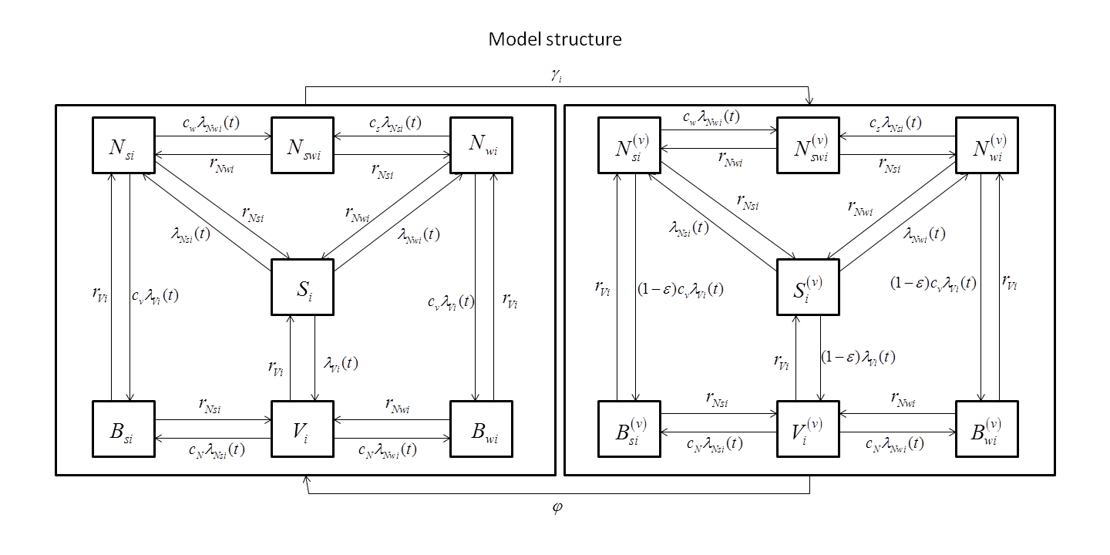
Unvaccinated
Vaccinated

Slide 5
Methods: Model calibration
The model will be fitted to pre-vaccination carriage prevalence data to estimate some parameters.
The waning rate of vaccine induced protection against carriage and the vaccine efficacy against carriage will act as control parameters
Clearance rates to be obtained from studies investigating the nasopharyngeal carriage and clearance rates among Kenyan study subjects

Slide 6
Methods: Likelihood
Denote the number of individuals in the ith age group and jth pre-vaccination carriage status in the empirical calibration data by
Denote the vectors containing the model output of the serotype distribution in the ith age group by

Slide 7
Methods: Likelihood
The counts, , in the ith age group will follow a multinomial distribution with the log-likelihood function given by:
The combined log-likelihood for all the age groups is then given by:

Slide 8
Methods: Estimation
Given any set of parameters the model generates the steady-state serotype distribution.
The likelihood for any given set of parameters is can then be computed using equation 5.
The likelihoods are used within a Metropolis-Hastings MCMC algorithm to estimate the best set of parameters that fit the observed data.

Slide 10
Model equations

Slide 11
Force of infection

