Slide 1
Strathmore University International Research meeting
23-27 July, 2012
Nairobi
Enhancing mathematics research in african Universities through international collaboration

Slide 2
‘Conventionalization’ of numerals in the Tanzanian mathematics Classroom:
Effect on relational understanding of arithmetic operations
By Peter Kajoro
The Aga Khan University, Institute for Educational Development, East Africa

Slide 3
Definition of Convention
Variously defined;
Will adopt David Lewis's celebrated analysis in Convention (1969). A social convention is a regularity widely observed by some group of agents. But not every regularity is a convention. We all eat, sleep, and breathe, yet these are not conventions. In contrast, the fact that everyone in the United States drives on the right side of the road rather than the left is a convention. We also abide by conventions of etiquette, dress, eating, and so on.
taken verbatim from Stanford Encyclopedia of philosophy retrieved http://plato.stanford.edu/entries/convention/ on the 10th July, 2012

Slide 4
Convention: definition continued….
Social Conventions are not necessarily adopted through “agreements” in the sense of convening a meeting and passing a resolution!

Slide 5
Definition continued…
David Hume, in the Enquiry Concerning Human Understanding, a convention is
a sense of common interest; which sense each man feels in his own breast, which he remarks in his fellows, and which carries him, in concurrence with others into a general plan or system of actions, which tends to public utility (p. 257)
taken verbatim from stanford Encyclopedia of phylosophy retrieved http://plato.stanford.edu/entries/convention/ on the 10th July, 2012

Slide 6
Conventionalization of …. (definition...)
The process or act of ‘inadvertently’ making something become a convention.

Slide 7
Group of agents
Citizens of a nation;
Villagers;
Lawyers;
Teachers in a particular school;
Mathematicians; OR
Mathematics teachers

Slide 8
Curriculum requirements
Mathematics teaching should aim at “developing and promoting self-confidence and an inquiry mind” through the use of an investigative approach
(Ministry of education and vocational training (2005))

Slide 9
Teaching reality in the maths classroom ( teaching of numerals)
My experience, derived from CEPs phase two observations, point to the fact that numerals for ten, eleven, twelve, thirteen, fourteen etc. are presented as 10, 11, 12, 13, 14 like they were conventions!!!
Numerals for numbers equal to and greater than ten are conventionalized.

Slide 10
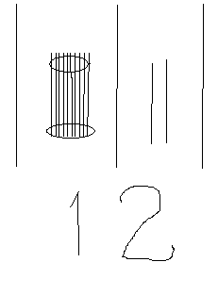
Place value principle ignored

Slide 11
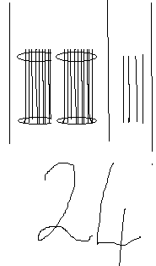
Place value ignored continued…

Slide 12
Concept image ( Mental picture )
The total cognitive structure that is associated with the concept, which includes all the mental pictures and associated properties and processes. It is built up over the years through
experiences of all kinds, changing as the individual meets new stimuli and matures.
David Tall and Shlomo Vinner -Educational Studies in Mathematics 12 (1981) 151-169.

Slide 13
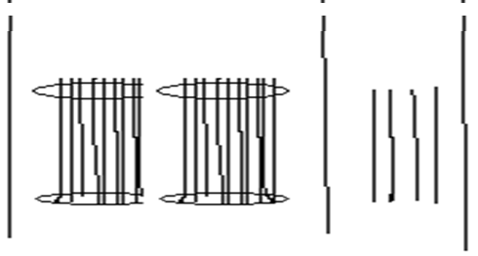

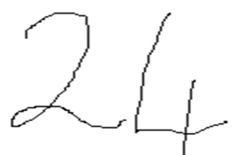
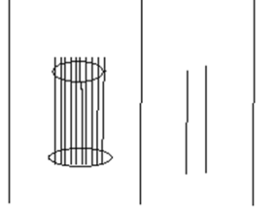

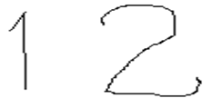


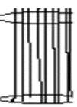
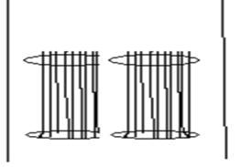
addition

Slide 14
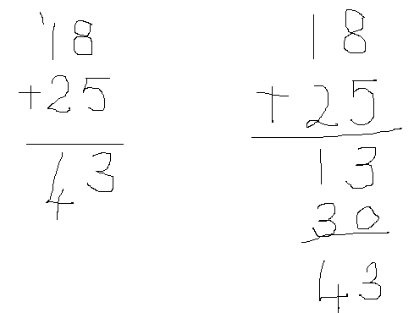
Addition (convention)

Slide 15
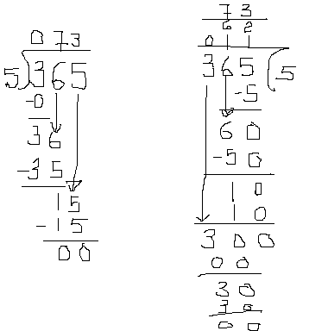
Division convention

Slide 16
Conclusion
The 2011 Uwezo Tanzanian Uwezo National report concluded that : only three out of ten stardard three pupils could add, subtract and multiply.
The report recommends more time be spent on basics of foundational mathematics

Slide 17
Acknowledgement
The content of this presentation first appeared in the Journal of Mathematics Teaching 227- a Journal of the Association of Teachers of Mathematics -titled Conventionalization of Numerals in Tanzania by Peter Kajoro.

Slide 18
Thank you

