Slide 1
Markov chain modeling of rainfall data with GenStat
by
Jacob Otieno Ong’ala
Strathmore University, Nairobi (Kenya)
AASC2012,
Crowne Plaza - Queenstown (New Zealand)
7th Dec 2012

Slide 2
Outline
Motivation
Analysis of rainfall data
Markov Chain modeling of rainfall
A demonstration.

Slide 3
Motivation
Climatic data is one of the most important data that is used for decision making in Agriculture, Health's, Tourism, Industrial sector etc.
Resources spent in the gathering of these data should have positive correlation to the results due to the data.
In Kenya (developing countries), a lot of resources have been spent in establishing met stations.
Today Kenya has established atleast a met station in each district and in addition other research institutions has the same. The same story in other developing countries.
Surprisingly, the data generated is still underutilized. The value of the input does not correlate with output.
The questions to address: Methods of collection, data management, methods of analysis, usage of the results.
A lot of research still needs to be done on these areas (potential researchers)

Slide 4
Rainfall Data management and analysis
Rainfall data is potential in giving insight to many decision makings.
It is quite challenging onto how it is managed and analyzed: Some of the reasons behind this are: non-normal distributions of rainfall, lack of right procedures for analyzing them etc.
Some of the common methods that have been used in Kenya for analyzing rainfall data are: descriptive analysis & trends which may not give much information for prediction.
However a number of research work have been done sowing better and advanced ways of analyzing rainfall data (Gabriel , & Neumann. (1961), Buchdahl, J. (1999), Gallagher & Stern (2004) etc.)
Most researchers have not embraced the used of these advanced methods of analysis due to their complexity and unavailability of procedures for use.
Today Instat statistical package has incorporated some of the advanced approaches though it has difficulty in handling the GLM

Slide 5
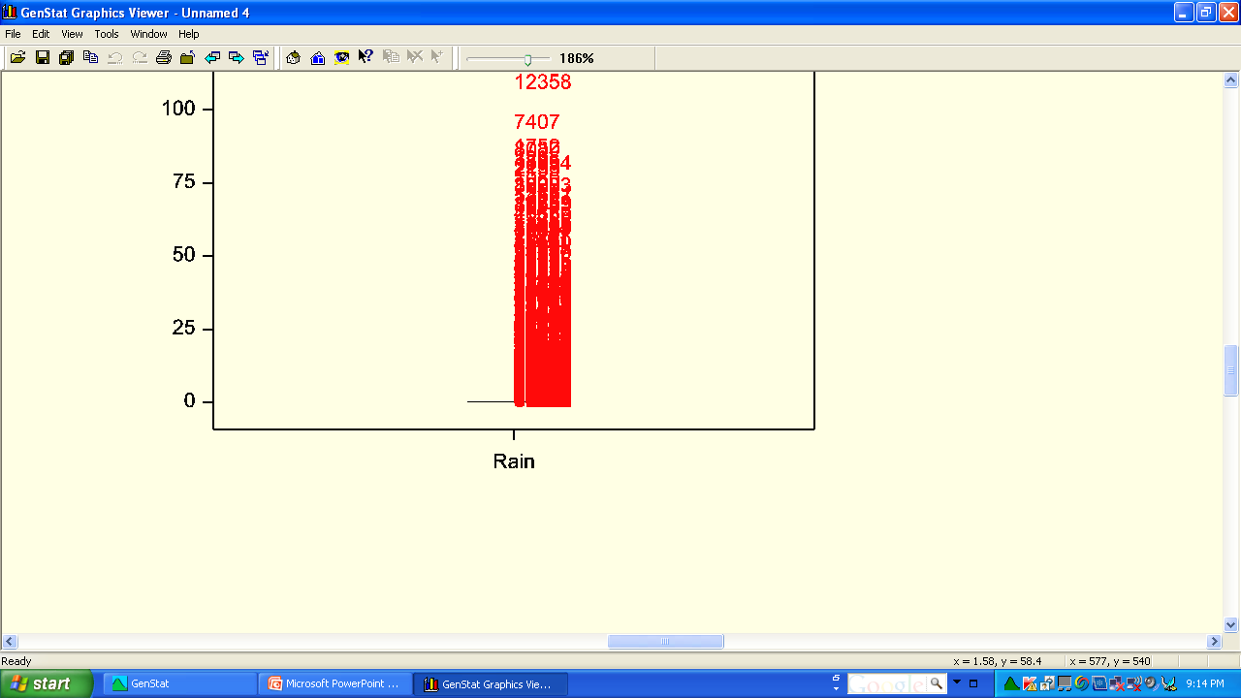
Some common mistakes in rainfall analysis
Descriptive Analysis of rainfall
Mean = 1.898
Median = 0
Lower quartile = 0
Upper quartile = 0
Looking at the output for descriptive analysis of rainfall data from Katumani station in Kenya shows that more than 75% of the data is 0.
The box plot display shows that almost all rainfall data are outliers ( the interpretation of this assumes that there is normality no rain in this region ) this is not practically

Slide 6
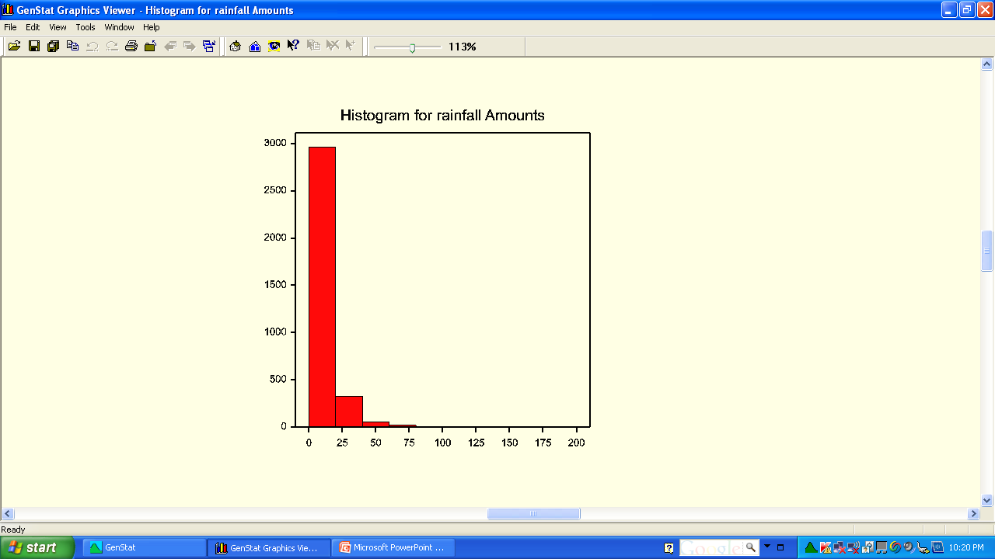
Rainfall data analysis
If the data is divided into two; the zeros and the non-zeros data, then analyzed, a better results can be obtained.
The display of rainfall amounts (non-zeros) shows that the amounts is not normal and therefore we think of other continuous distribution possibly gamma distribution.
Therefore, we can model rainfall data in two approaches
Occurrences (Binomial)
Amounts (probably gamma)

Slide 7
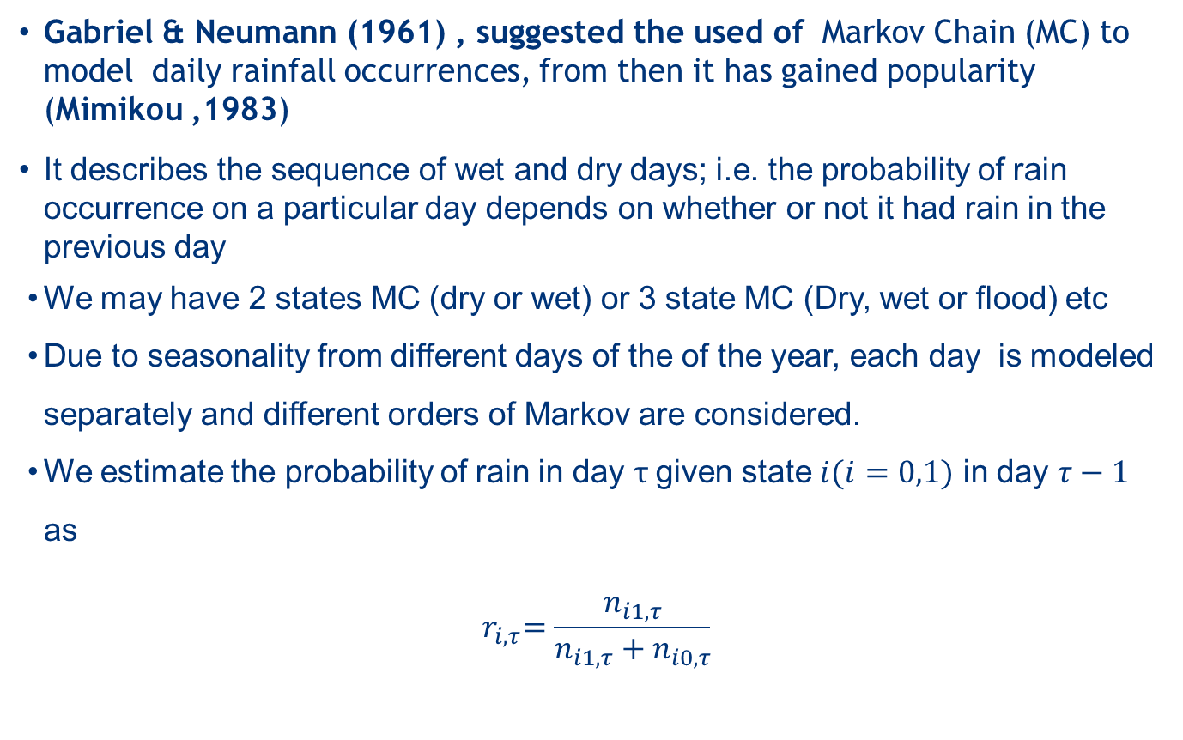
Markov Chain modeling of Rainfall occurrences
Gabriel & Neumann (1961) , suggested the used of Markov Chain (MC) to model daily rainfall occurrences, from then it has gained popularity (Mimikou ,1983)
It describes the sequence of wet and dry days; i.e. the probability of rain occurrence on a particular day depends on whether or not it had rain in the previous day
We may have 2 states MC (dry or wet) or 3 state MC (Dry, wet or flood) etc
Due to seasonality from different days of the of the year, each day is modeled separately and different orders of Markov are considered.
We estimate the probability of rain in day $τ$given state $i(i=0,1)$ in day $τ−1$ as
$${ r}_{i,τ}=\frac{n_{i1,τ}}{n_{i1,τ}+n_{i0,τ}}$$

Slide 8
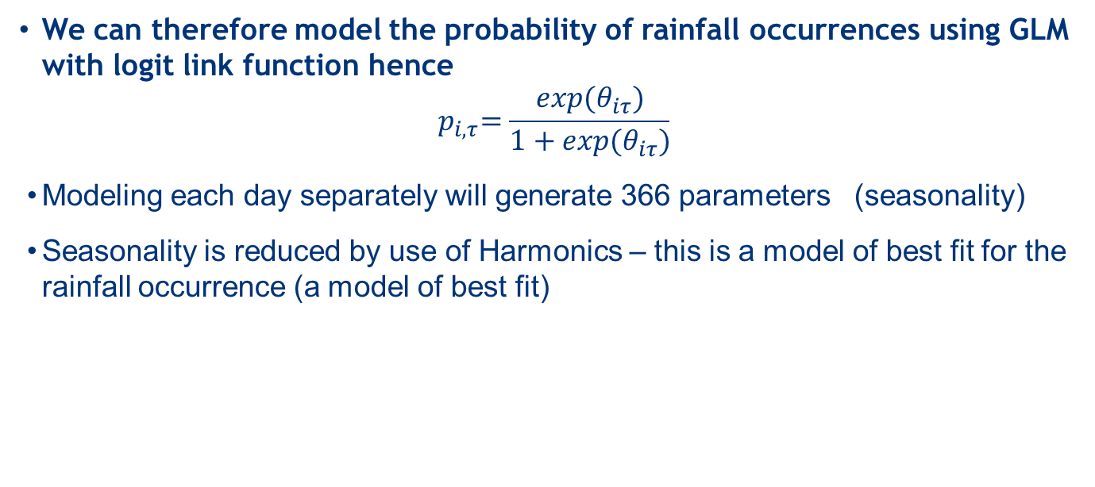
Modeling Rainfall occurrences
We can therefore model the probability of rainfall occurrences using GLM with logit link function hence
$${ p}_{i,τ}=\frac{exp(θ_{iτ})}{1+exp(θ_{iτ})}$$
Modeling each day separately will generate 366 parameters (seasonality)
Seasonality is reduced by use of Harmonics – this is a model of best fit for the rainfall occurrence (a model of best fit)

Slide 9
Harmonics explained
Because of the daily variations (BLUE zig-zag line ) we find a model that will have less variation.
The yellow shows a fitted line with higher harmonic than the red line.

Slide 10
Order of the Mc
More parameters are generated due to the order of the chain
2 parameters are generated for order 0; P_w & P_d
4 parameters are generated for order 1; P_ww , P_wd, P_dw & P_dd
8 parameters are generated for order 2 (high order MC )and so on.
Working with up to order 1 is still accommodated, but beyond order 1 is quit tedious
By memory less property, P_dwd = P_dww => ‘P_dw’
Hence eight parameters are reduced to two and so on

Slide 11
Order of the MC

Slide 12
Order of the Mc
More parameters are generated due to the order of the chain
2 parameters are generated for order 0; P_w & P_d
4 parameters are generated for order 1; P_ww , P_wd, P_dw & P_dd
8 parameters are generated for order 2 (high order MC )and so on.
Working with up to order 1 is still accommodated, but beyond order 1 is quit tedious
By memory less property, P_dwd = P_dww => ‘P_dw’
Hence eight parameters are reduced to two and so on

Slide 13
Modeling rainfall amount
Looking at the box plot again after separating the data into rain and no rain, The data is still skewed to the right and bounded on one side (Rain>0) and does not take the value zero
50% of the data are slightly beyond 0.
The amounts is therefore modeled for rainy day which is hypothesized to take a gamma distribution

Slide 14


Our dream
Implement Specialized routine for Markov modelling in GenStat.

Slide 15
Work done so far
Counts
Probabilities
Fitting probabilities
Fitting amounts

Slide 16
Work done so far
The result of this work can now be demonstrated
We analyze the rainfall data from Katumani, Kenya using the new dialogs
Lets take a look at the data
Organize the data and demonstrate analysis here

Slide 17
Further work
Implementing routines for
Climatic events
Crop performance index analysis,
Summaries of climatic data
Collaborating with other researchers who also do similar work
Crop modeling
Simulation
Implementation of climatic menu in other statistical packages.

Slide 18
Detailed Reading and references
A thesis
Publisher: Lambert Academic Publishing
ISBN : 978-3-8454-0575-9
Title : Simplifying the Markov chain analysis of rainfall data using GenStat
Get it online:
https://www.morebooks.de/store/gb/book/simplifying-the-markov-chain-analysis-of-rainfall-data-using-genstat/isbn/978-3-8454-0575-9

