Slide 1
International Mathematics Research Meeting
Mathematical Biology Workshop
Modeling the Dynamics of Bacteremic Pneumonia:
The role of Control Strategies, Case Detection and
Prophylaxis.
By
Otieno Ong’ala,

Slide 2
Outline
Model framework used
Models of Pneumonia transmission dynamics
Basic reproduction number
Probabilistic simulation of the R0
Optimal control.

Slide 3
Framework
Problem Identification
&
Information Search
Basic model
Model with control
Misdiagnosis and mistreatment model
Model Formulation
Pneumonia Transmission Dynamics
Probabilistic Approach
Non-Probabilistic Approach
R0
Equilibrium point
Stability
Bifurcation
Validation and Simulation
Model Analysis

Slide 4
Background Information
Pneumonia is a respiratory disease characterized by an inflammatory condition of the lungs.
The disease is mostly caused by a bacteria called Streptococcus Pneumoniae.
The bacteria invades in the alveoli and passages of the lung.
It grows rapidly in number filing the area with fluid and pus causing difficult and painful breathing resulting to limited oxygen intake
The bacteria can be transferred from infected to susceptible leading the spread of the disease through sneezing or coughing.
The bacteria can also be contained in the respiratory track of a normal person without causing the disease unless it moves to the lower part of the track (carriers)

Slide 5
Problem Statement
Pneumonia is infectious and claims about 1.9 millions children annually in the developing countries
In Kenya up to 16 % of child mortality is contributed by pneumonia .
The management of the disease is challenging due its overlap of symptoms with other diseases like malaria hence leading to its mistreatment.
It is a fast killer disease and therefore prompt diagnosis and treatment with right drug is needed
A mathematical research to understand the dynamics of the disease may suggest how to promptly diagnose, effectively treat and deduce other prevention strategies for pneumonia before the outbreak

Slide 6
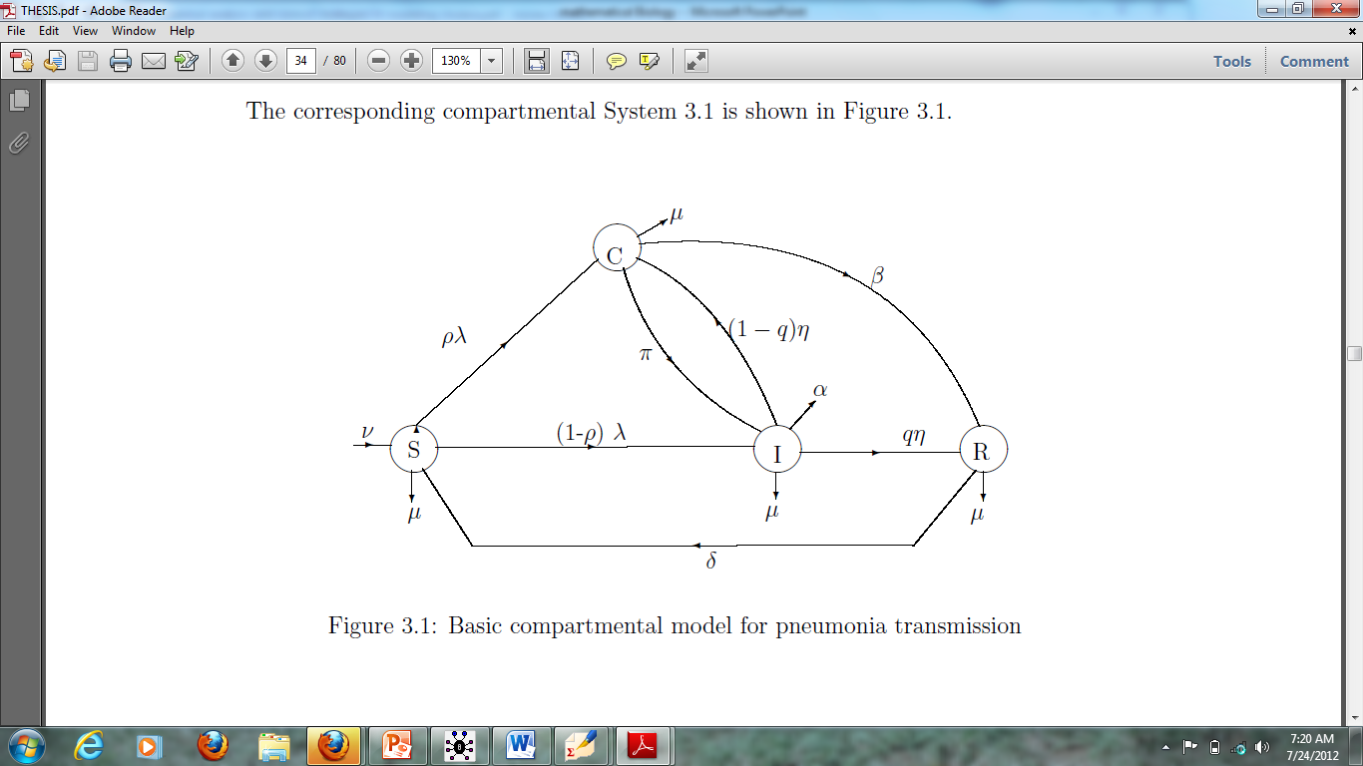
Model Formulation(with control)

Slide 7
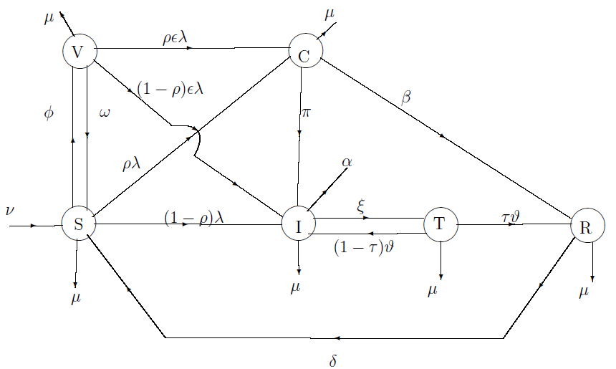
Model Formulation(with control)

Slide 8
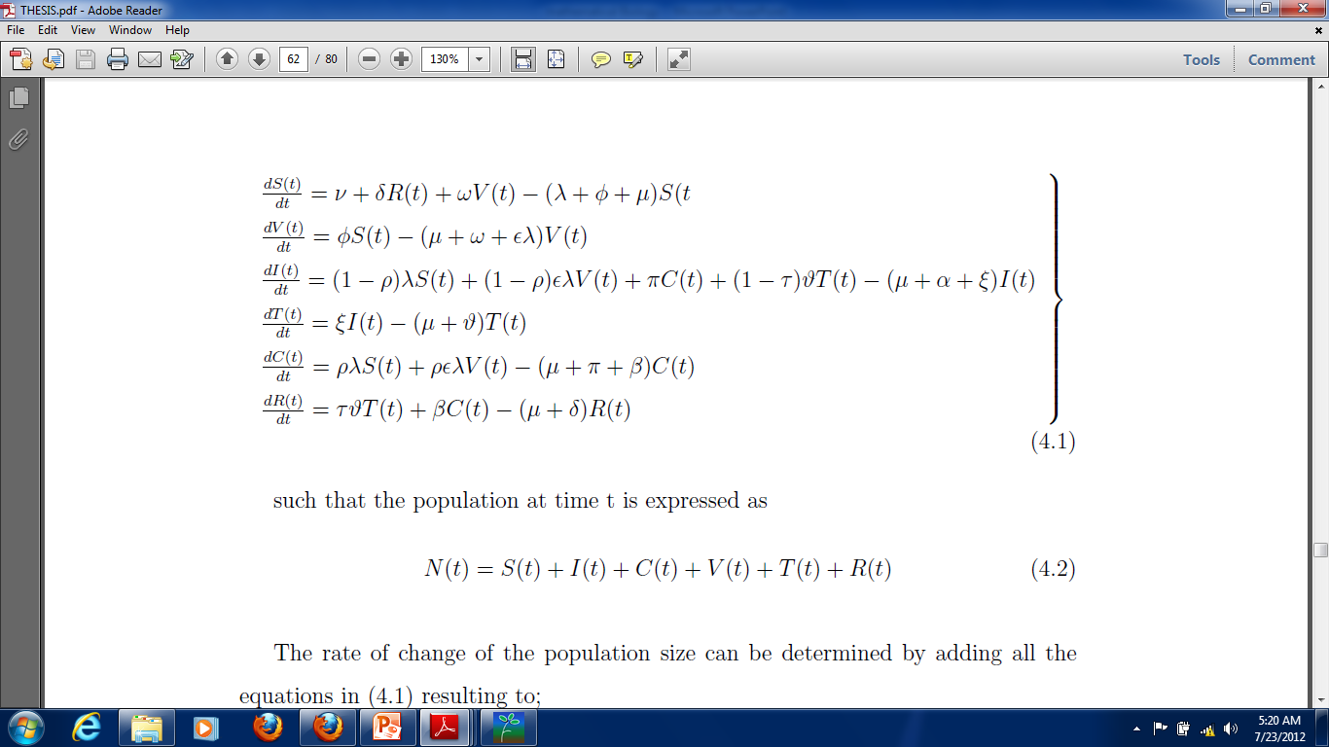
Model formulation

Slide 9
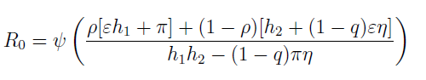
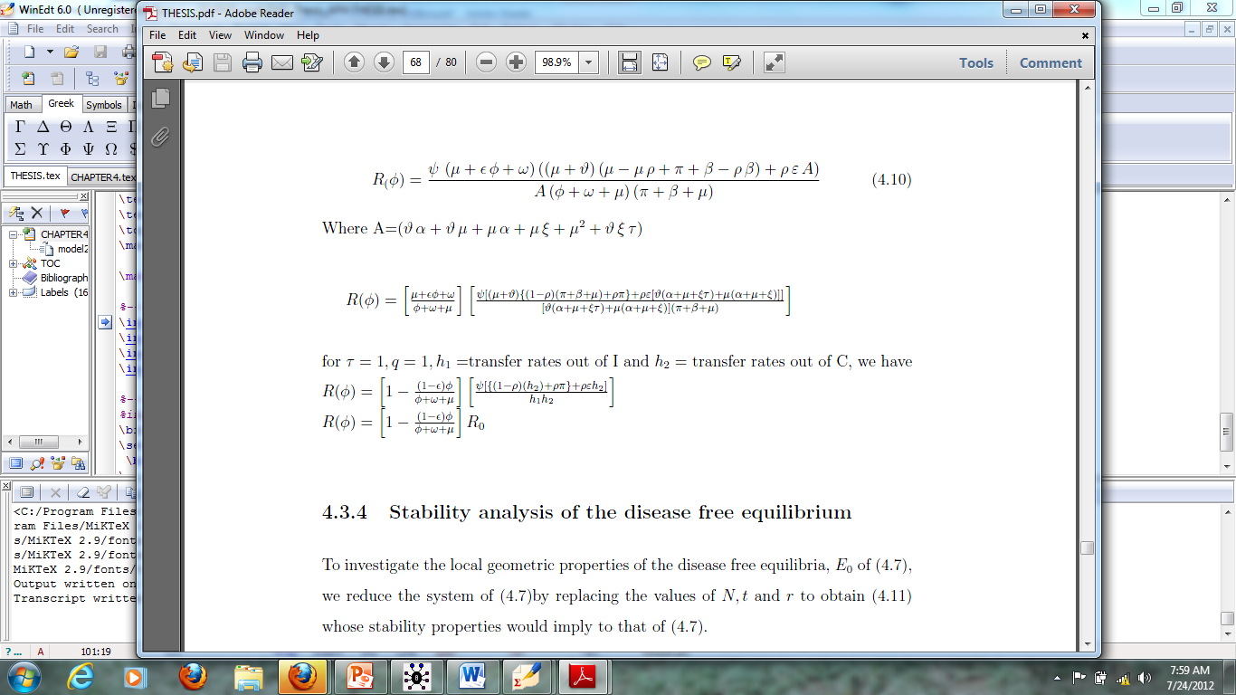
Basic Reproduction Number
We use the next generation operator method to compute R0
Making τ=1, q=1, h1 and h2 are transfer rates out of I and C
Therefore R(φ)< R0

Slide 10
Probabilistic simulation of R(φ)
Let the parameter on the RHS be RV following certain distribution i.e
µ~Exp (a)
Ø~ Uniform (0,1) etc
Then Ro will be a random variable following certain distribution
The distribution of Ro can be determined using contraction of mixed distribution or through MCMC simulation

Slide 11
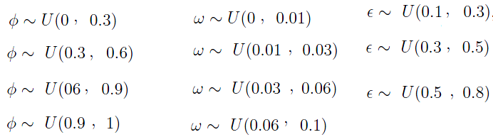
MCMC Simulation of R(φ) using vaccination parameters
the vaccination parameters are (ø,ω,ϵ)

Slide 12
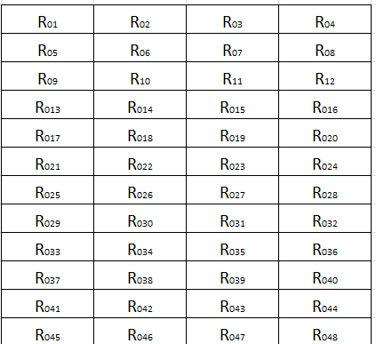
Which R0 will be optimal

