Slide 1
Does co-prescription of statin drugs and its contraindications increase the risk of liver injury? The self-controlled case series approach
Henry. K. O. Athiany
JKUAT, STACS Department
Statistical Modelling Workshop
Strathmore University 23rd -27th July, 2012

Slide 2
Presentation outline
Background/Intro
Literature review (Systematic)
Aims and Objectives
THIN Database
The case-series design
Case-series approach
  Results, findings, summary
Results in context: Implications

Slide 3
Background/Introduction
Cardiovascular disease (CVD)
Statin drugs (…most widely prescribed in the UK)
  Atorvastatin(lipitor), Fluvastatin(lescol), Cerivastatin(lipobay), Pravastatin(pravachol), Rosuvastatin(crestor), Simvastatin(zocor)
Statin drug metabolism
  Cytochrome P450 3A4 (CYP3A4)
Statin Contraindicated CYP3A4 Inhibitor Drugs (SCCID)- (short-term: indication for use)
  azole antifungals: fluconazole, ketoconazole, …
  macrolide antibiotics: clarithromycin, telithromycin,…
  Immunosuppressant : cyclosporine
Drug Induced Liver Injury (DILI)

Slide 4
Literature reviews (LRs)
Three part systematic reviews on risk of liver injury in:
  Chronic statin drug users
  SCCID users
  Concomitant statin drug and SCCID users
Why three LRs?

Slide 5
LR(1): Findings & summary
Chronic statin drug use (1987-2011): results indicate;
Four (4) studies identified
Strong evidence that statin exposure is associated with higher risk of liver injury compared to non-exposure to statin drugs. (esp. 1st one year of statin drug therapy)
Evidence of carry-over effects of statin drugs on risk of liver injury (rtn to normal 1yr later)
Exposure to high dose statin may be assoc with higher risk of liver injury than low dose statin drug exposure
Notes:
Aim: Present the evidence on the association between statin drug use and the risk of liver injury.
Despite the limitations listed ….the following were the findings of the review on the relationship between statin drugs exposure and the risk of liver injury in the period 1987-2011.

Slide 6
LR(2): Findings & summary
SCCID users (1987-2011):
Five (5) studies identified
Review supports the hypothesis that exposure to SCCID (macrolides antibiotics-erythromycin, clarithromycin, telithromycin; fluconazole) is associated with higher risk of liver injury compared to non-exposure (baseline) to these drugs.
Potential confounders identified: gender, age, ethnicity, cigarette smoking, co-morbidities, diabetes, e.t.c
More research to clarify on the relationship between SCCID and the risk of liver injury.
Notes:
Aim: Present the evidence on the association between SCCID use and the risk of liver injury.

Slide 7
LR(3): Findings & summary
Concomitant statin drug and SCCID use
  No studies identified
  First study to review the literature on the association between risk of liver injury and exposure to co-prescription of statin drugs and SCCID among adult chronic statin users.
  Results supports the need to carry out a population based study, to assess this association among adult patients on long-term statin therapy.
Notes:
Aim: Present the evidence on the association between co-prescription of statin drug and SCCID and the risk of liver injury.
To my knowledge, this appears to be the ………..
Results of this review was a motivation of the current study on the risk of liver given co-prescription of statin drugs and SCCID to chromic statin users.

Slide 8
LR: Overall summary
  Exposure to statin drugs or SCCID is associated with higher risk of liver injury than non-exposure to these drugs.
  There is limited/no evidence of research (1987-2011) that has considered assessing the association between co-prescription, and eventually concomitant exposure to both statin drugs and SCCID, and the risk on liver injury.
Notes:
In summary I can say that……..
SCCID(macrolides antibiotics-erythromycin, clarithromycin, telithromycin; fluconazole)

Slide 9
Aim
To asses the association between co-prescription of statin drugs and statin contraindicated CYP3A4 inhibitor drugs (SCCID), and the risk of liver injury using data from a sample of the UK adult population, adjusting for potential confounders using the Self-controlled case-series design

Slide 10
Objectives
To asses and quantify the association between co-prescription of statin drugs and SCCID and first liver injury event.
To assess the confounding effect of age in the association between co-prescription of statin drugs and SCCID and the risk of liver injury.

Slide 11
Objectives
To assess the effect on the risk estimates with regard to changing the length of the carry-over risk periods.
To assess the assumptions of the case-series method as a way of checking its validity for the current study.

Slide 12
The Health Improvement Network (THIN) Database
Primary care in UK has a very comprehensive coverage of the population:
  98% registered with a general practitioner (GP)
  Patient visit results in: offer advice, prescribe drug, refer to a specialist or further tests
  Medical and prescription data are recorded
    Presc data:- dosage; prescription quantity; amount; free text
  Several databases: GPRD, THIN, QResearch
THIN, large GP database, longitudinal patient records retrieved from practicing GPs across UK
  Data collection began, 2003 (1988);

Slide 13
The Health Improvement Network (THIN) Database
  By August 2006, data from 326 practices, 5.5m patients, 2.5 actively registered, formed 4% of the UK population.
  By Jan, 2011; 503 practices, 9.15m patients, 3.54 actively registered; representing ~6% of the UK population.
  THIN demographically representative of the UK Pop. Patient information organised in:
    Demographics: gender, dob, date of registration/leaving practice
    Diagnosis: medical diagnosis, date of diagnosis, free text (if available)
    Prescribing: presc and presc dates, formulation, strength, qty and dosing instruction.
    AHI: Info on lifestyle and health factor e.g smoking, alcohol intake etc
    SES/SEP

Slide 14
What is the case-series method?
The self-controlled case series (SCCS) method is an alternative study method for investigating the association between a transient exposure and an adverse event.
The method was developed to study adverse reactions to vaccines (MMR Vaccine-1992). The method uses only cases, no separate controls are required as the cases act as their own controls.
Whitaker et al, 2005
Whitaker et al, 2005

Slide 15
What is the case-series method?
Time-varying confounding factors such as age can be allowed for by dividing up the observation period further into age categories. An advantage of the method is that confounding factors that do not vary with time, such as genetics, location, socio-economic status are controlled for implicitly.
Each case's given observation time is divided into control and risk periods. Risk periods are defined during or after the exposure. Then the method finds a relative incidence, that is, the incidence in risk periods relative to the incidence in control periods.
Whitaker et al, 2005
Whitaker et al, 2005

Slide 16
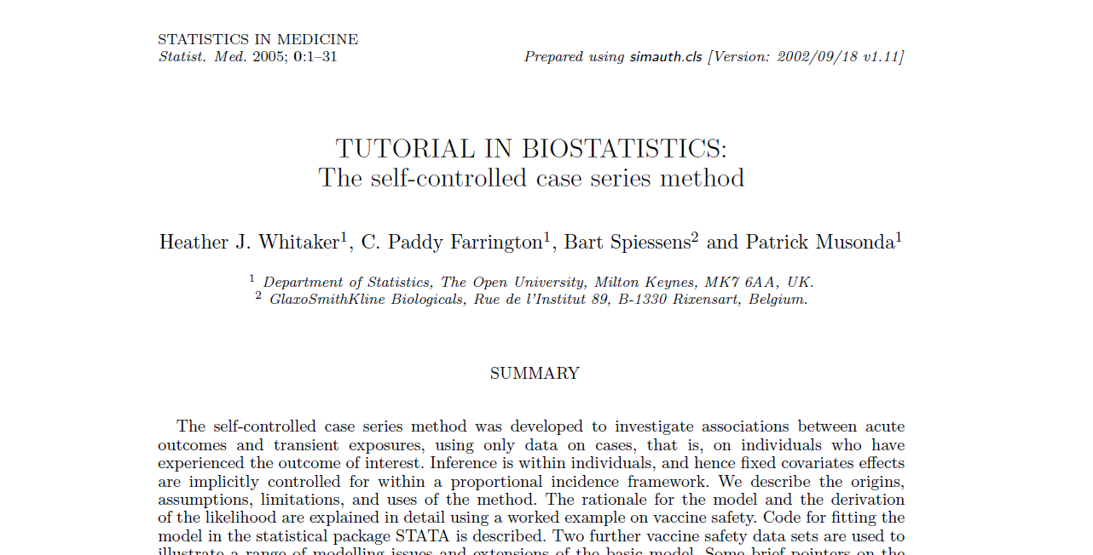

Slide 17
A general illustration of a case's observation time divided into control, risk periods and age-bands
“Event”
Liver injury
Risk period
Risk period
Start of observation
End of observation
Fig. 1
Individual i
*
Control period
Age group 1
Age group 2

Slide 18
Case series: Summary
It is a conditional cohort method: exposures are regarded as fixed, event times as random.
Follow-up is not censored at event.
The method can be used with independent recurrent events, or uncommon non-recurrent events.
Only cases are required: estimation is within-individuals.
The analysis is self-matched, thus eliminating the effect of fixed confounders.
It has been programmed in standard statistics packages.
Whitaker et al, 2005

Slide 19
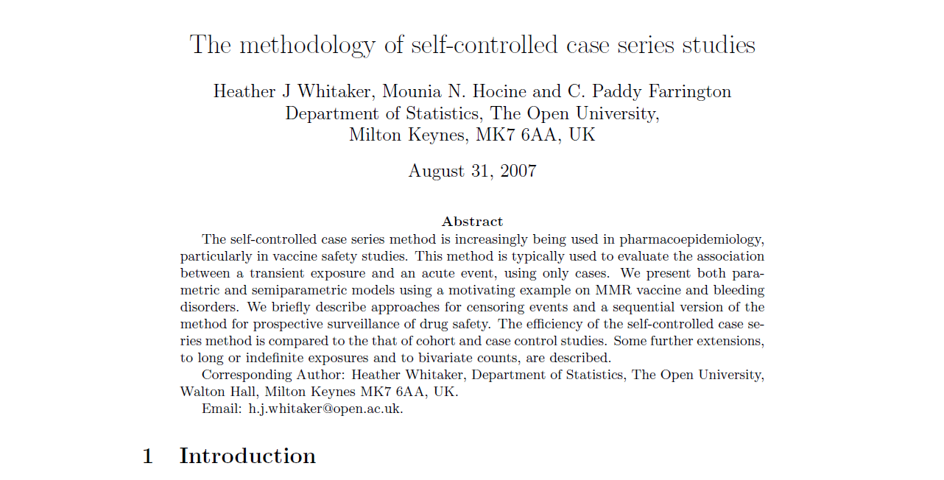

Slide 20
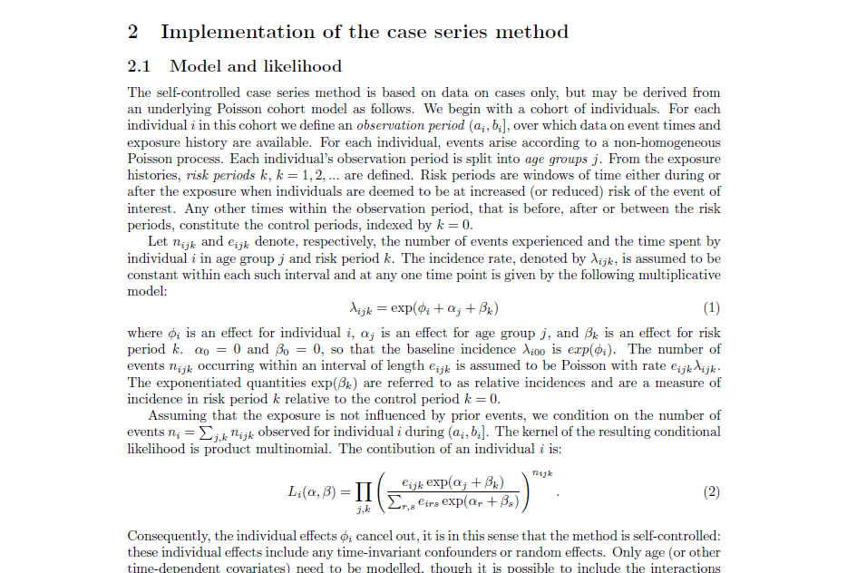
Whitaker et al, Stat Methods Med Res. 2009 Feb;18(1):7-26

Slide 21
However…
The method has three stringent assumptions:
Independent but recurrent events within an individual
The occurrence of an event must not alter the probability of subsequent exposure.
The occurrence of the event of interest must not censor or affect the observation period.
Notes:
If recurrent events are not independent yet the occurrence of a first event is rare, then the
method can be applied using just the first event.

Slide 22
More details on the Website (created by Heather Whitaker) http://statistics.open.ac.uk/sccs/papers.htm
Tutorial paper:
Whitaker et al., Statist. Med. 2006, 25: 1768 – 1797
Other papers:
  semi-parametric model: avoids mis-specification of age specific baseline incidence, (Farrington CP and Whitaker HJ, 2006)
  sample size estimation, (Musonda et al, 2006)
  small sample performance (Musonda et al, 2007)
Example datasets and analysis files in Stata, SAS, GENSTAT, GLIM and R.

Slide 23
The case series approach
using THIN Dataset

Slide 24
Examples of four possible timings of the outcome event
liver injury for a patient in a follow-up period
Liver injury
Case 1
3 months
6 months (event free)
Liver injury
Case 2
3 months
6 months (event free)
Liver injury
Case 3
3 months
6 months (event free)
Liver injury
Case 4
3 months
6 months (event free)
Baseline period
Date of registration with a practice
Periods of statin only therapy
Start of observation period
Fig. 4
Periods of both statin and SCCID therapy
End of observation period
Periods of SCCID only therapy
Notes:
SCCS

Slide 25
Definitions
Drug exposures
  Statin drug alone
  ‘may be’ statin drug alone
  SCCID exposure
  Co-prescription of statin and SCCID-main exposure of interest
  -repeat and multiple drug exposures
Outcome
  Liver injury in the observation period

Slide 26
Statin alone and ‘maybe’ statin alone exposure definition
Fig. 2
Notes:
Figure showing the start and stop points of statin drug; and restart of statin therapy in the observation period.
After restart of statin therapy, the last prescription in this figure was within six months to the end of observation period (implying continuous therapy).

Slide 27
Definition of repeat statin only exposure, and multiple statin drug exposure in the observation period
Fig. 3
Notes:
Case series design can handle both repeat and multiple exposure periods.
Single variable to indicate that…..0,1,2,3,4

Slide 28
Participants and Data management (DM)
Aged ≥18yrs at entry into the study
Diagnosed with DILI ≥ 9moths after registration with practice
Had ≥1 presc of statin/SCCID in the obs prd
DM
Statin exposure-cont. unless interval >6m
SCCID-prescription duration
Exposure periods-See Fig 5

Slide 29
An illustration of an individual case timeline with
exposures to single drugs and co-prescription
Fig. 5
Event, Liver Injury
Notes:
Data Management:
Exposure periods: continuous exposure to statin alone, SCCID alone or co-prescription of statin and SCCID
Overlapping risk periods: In the case of C, if an event occurs at any point within C, then that event will be classified as exposed to co-prescription of statin and SCCID. This means co-prescription takes precedence, but does not necessarily replace exposure to statin drugs alone.

Slide 30
Case series: Results (1)
Rate ratios of first liver injury event in the four possible drug exposure periods in a patient’s timeline given seven-days carry-over period
Notes:
Rate ratios of first liver injury event in the four possible drug exposure periods in a patient’s timeline given seven-days carry-over period

Slide 31
Case series: Results (2)
Summary of the sensitivity analyses results with the seven-day carry-over period

Slide 32
Main findings/discussions
Sig. higher rate of first liver injury event in the periods of:
  co-prescription of statin drugs and SCCID
  ‘may be’ statin drugs alone
  SCCID alone
  Compared to baseline (unexposed periods)
Rates attenuated with increased carry-over intervals
No evidence to support hypothesis…..
Notes:
Case series: No evidence to support the hypothesis of higher risk of first liver injury event being associated with co-prescription of statin drugs and SCCID compared to the risk of prescribing statin drugs alone or SCCID alone.

Slide 33
Strengths and limitations
Strengths of the study:
  Dealing with both unmeasured and some measured confounding effect…residual confounding minimised; good face validity; data used has been validated; e.t.c
  Confounding by indication (sensitivity analysis-7days pre-exposure period)
Possible weaknesses:
  Misclassification of exposure periods, patient adherence not measured but assumed once drug was prescribed.
  True risk periods unknown (sensitivity analysis)
Notes:
Absolute risks are not estimated.

Slide 34
Overall Summary
Although the study has shown evidence of an association between periods of exposure to co-prescription of statin drugs and SCCID; statin drugs alone; or SCCID alone; compared to baseline (no drug), there is no evidence that periods of co-prescription of statin drugs and SCCID increased the risk of liver injury than when compared to periods of statin drugs alone or SCCID alone
These results, were less prone to the problem of confounding bias (in cohort design), and the validity of the results have been assessed thro sensitivity analyses of the stringent assumptions.

Slide 35
Results in context: implications
Lack of increased risk of liver injury as hypothesised in the study may be due to:
  Induction of alternative metabolic pathways
  Selective medication taking by patients (may be influenced by GP advice)
Clinicians to maintain close monitoring of statin drug users
Prescribers may use the results to make more informed decisions in prescribing SCCID to patients already on statin drug therapy.

Slide 36
Selected References
1. C. P. Farrington, H.J.W., Semiparametric analysis of case series data. Journal of the Royal Statistical Society: Series C (Applied Statistics), 2006. 55(5): p. 553-594.
2. Farrington, C.P., et al., Self-controlled case series analysis with event-dependent observation periods. Journal of the American Statistical Association, 2011(0): p. 1-10.
3. Farrington, C.P. and M.N. Hocine, Within-individual dependence in self-controlled case series models for recurrent events. Journal of the Royal Statistical Society: Series C (Applied Statistics), 2010. 59(3): p. 457-475.
4. Farrington, C.P., H.J. Whitaker, and M.N. Hocine, Case series analysis for censored, perturbed, or curtailed post-event exposures. Biostat, 2009. 10(1): p. 3-16.
5. Musonda, P., et al., Self-controlled case series analyses: Small-sample performance. Computational Statistics & Data Analysis, 2008. 52(4): p. 1942-1957.
6. Whitaker, H.J., et al., Tutorial in biostatistics: the self-controlled case series method. Stat Med, 2006. 25(10): p. 1768-97.
7. Whitaker, H.J., M.N. Hocine, and C.P. Farrington, The methodology of self-controlled case series studies. Stat Methods Med Res, 2009. 18(1): p. 7-26.

Slide 37
Thanks to:
Bloomsbury consortium & JKUAT(financial support)
Research supervisors
  Dr. Mariam Molokhia
  Dr. Dorothea Nitsch
  Prof. Nick Barber
General Practitioners
Patients who provided data for research
CEGEDIM strategic staff (THIN database)

