Slide 1
Bayesian belief nets
Michael Ingleby
- these are one of several possible inference frameworks used in intelligent agents and are important in artificial intelligence
-others involve strict logical inference in a predicate logic framework or something similar such as modal logic
- yet others operate by search of large possible-worlds spaces to formulate plans of action for an agent in an environment, optimising a plan for some sort of fitness criterion
- I shall focus on the kinds of probabilistic inference that belief nets can perform

Slide 2
Intelligent Agent Architecture:
Environment
Action Planner
Inference Engine
Actuators
Sensors
Pattern Extractor
Knowledge Base
NOISE
CLASSIFIER

Slide 3
Some concrete examples of intelligent agents
Speech-to-text agents
– ‘speech recognizers’, that decide what is being said
2. Biometric ID agents
– ‘fingerprint/iris-scan/earprint/voiceprint scanners’ that decide who is or has been present
Telemedical agents
– provide decision support for ECG, auscultation etc
‘Smart’ machines (cars, locomotives, manufacturing lines…)
– decide their own maintenance needs….predictively
5. The robot traffic cop (extension of the speed camera)
– directs vehicle drivers at an intersection, detects infractions and decides when to photograph licence plates, take mug-shots etc
…. concepts from statistical decision theory apply !
…. engender obligations to engineer them safely when the decisions are safety-critical (→death/injury) or mission-critical (→destruction of environment or agent)

Slide 4
Pattern extractors:
these units perform pattern recognition, converting raw numerical data from sensors into symbolic information
information is mathematical construct on the way to getting knowledge of an agent’s environment, and is not sensitive to irrelevant variation in the data
information is of course intimately connected to probability that the environment is in a certai state

Slide 5
Agent Architecture:
Environment
Action Planner
Inference Engine
Actuators
Sensors
Pattern Extractor
Knowledge Base
NOISE
CLASSIFIER

Slide 6
Knowledge base:
this unit stores information about symbolic patterns in the environment - represents the agent's image of its environment
if the information is extracted with certainty, then the agent need a logic to represent this image – such as predicate logic or modal logic (the mathematics of these logics is important to software developers where there is much research on so-called ‘process algebras’ which are logics of action)
if gathered data is noisy and the information extracted is subject to uncertainty, a statistical representation such as a Bayes’ belief net, a Markov process or a Brownian motion model will be needed (these types of statistical model are needed in agent research)

Slide 7
Agent Architecture:
Environment
Action Planner
Inference Engine
Actuators
Sensors
Pattern Extractor
Knowledge Base
NOISE
CLASSIFIER

Slide 8
Inference engines (statistical)
If the knowledge base is configured as a Bayesian net of environmental states, the usual conditional probability calculus can be used – this is the present focus
If, on the other hand, the knowledge base is a dynamical process such as speech with state transitions and possible observables, then a Hidden Markov Model supplies the inferences needed to predict how the environment is evolving
If, as in the case of markets and wear processes in complex machinery, there is a Brownian motion at work in the environment, then an Ito calculus may be needed to predict what the environment will do in terms of short-term state evolution

Slide 9
Agent Architecture:
Environment
Action Planner
Inference Engine
Actuators
Sensors
Pattern Extractor
Knowledge Base
NOISE
CLASSIFIER

Slide 10
Action planning: what sequence of actions should an agent perform ?
The simplest actions are production rules of the form ‘IF environment in state S, THEN do A to change its state’
Often there is a sequence of possible actions, when scheduling a salesman to call at different towns, or ordering the loading of a container to : there are algorithms to sequence actions efficiently
Needed ‘an empirical science of algorithms’ – schedulers and planners have not compared algorithms in statistically sound ways, but the research community is getting more thoughtful
Many algorithms are inspired by metaphors such as ‘simulated annealing’ or ‘ant-trail’ multi-agent ways of acting concurrently and involve optimisation of a fitness measure for actions

Slide 11
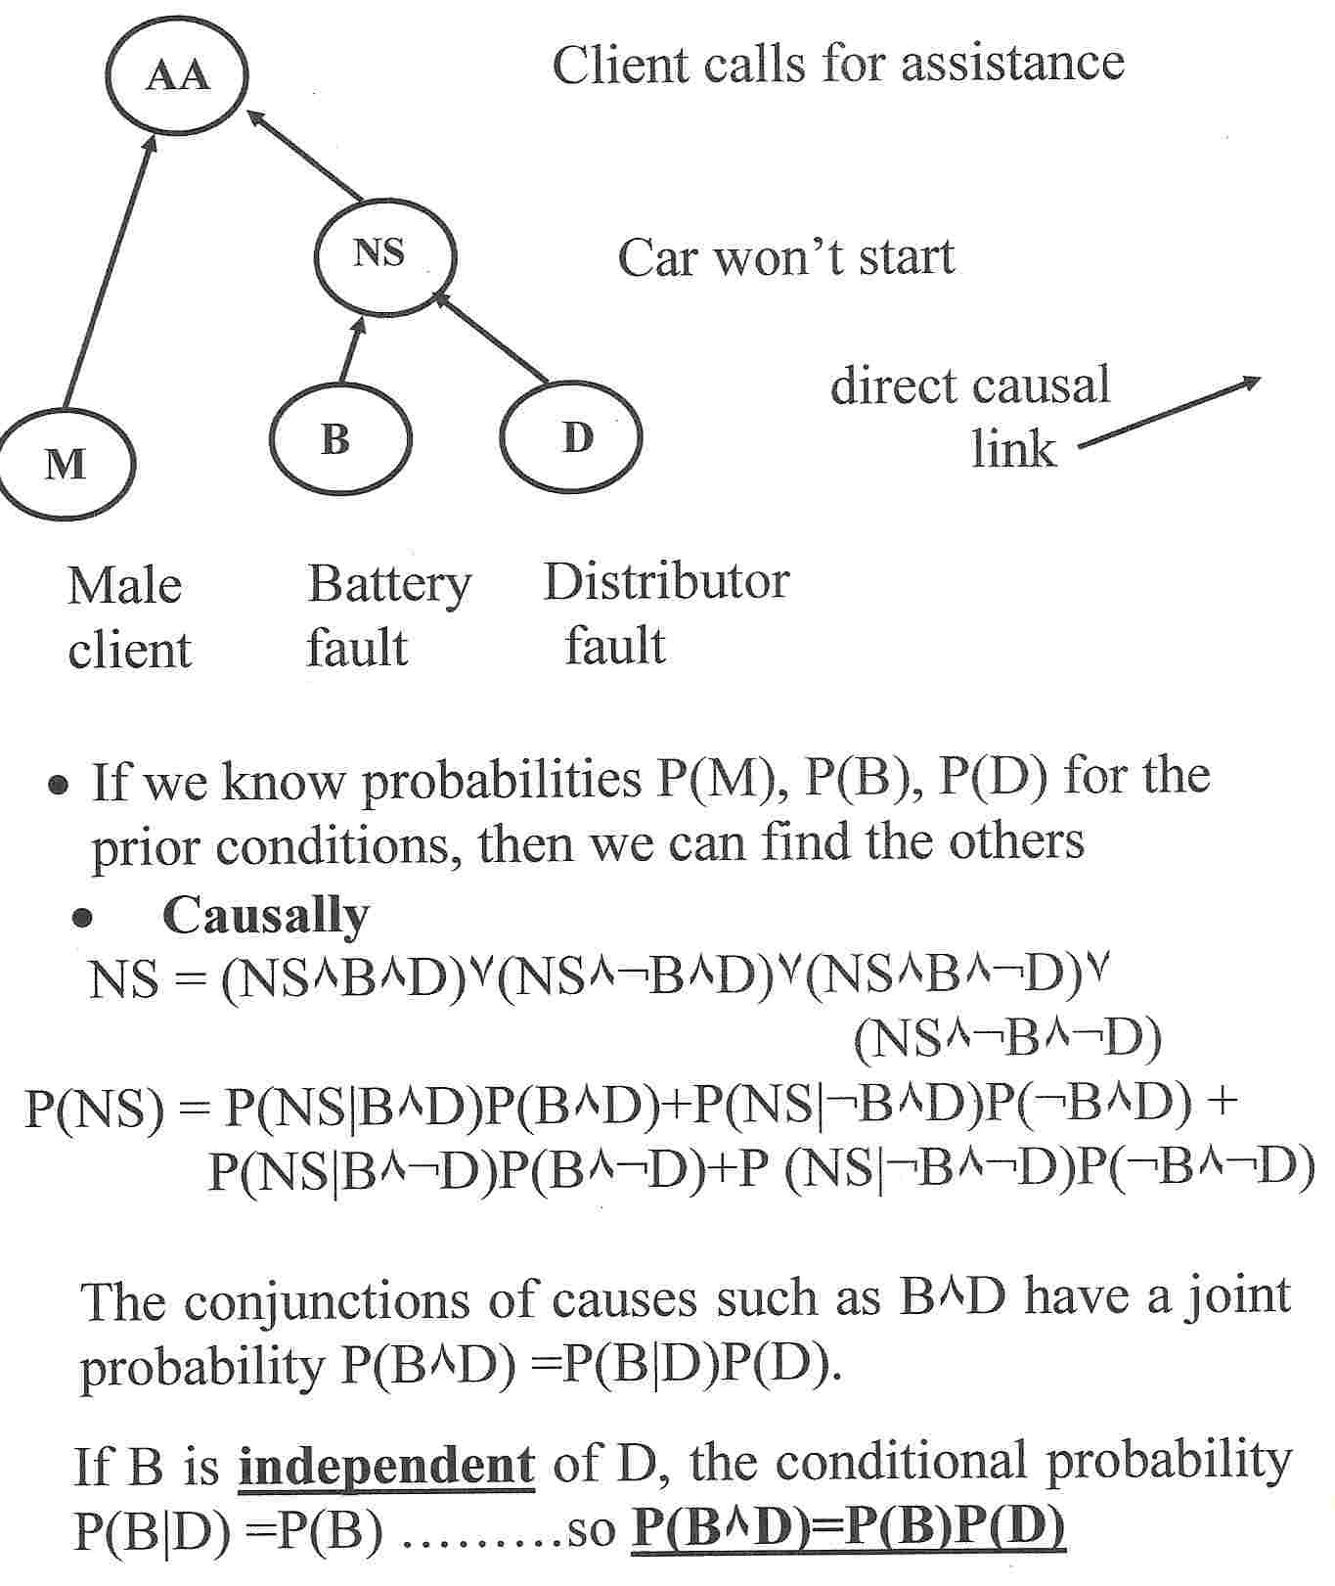
What are Bayesian Nets?

Slide 12
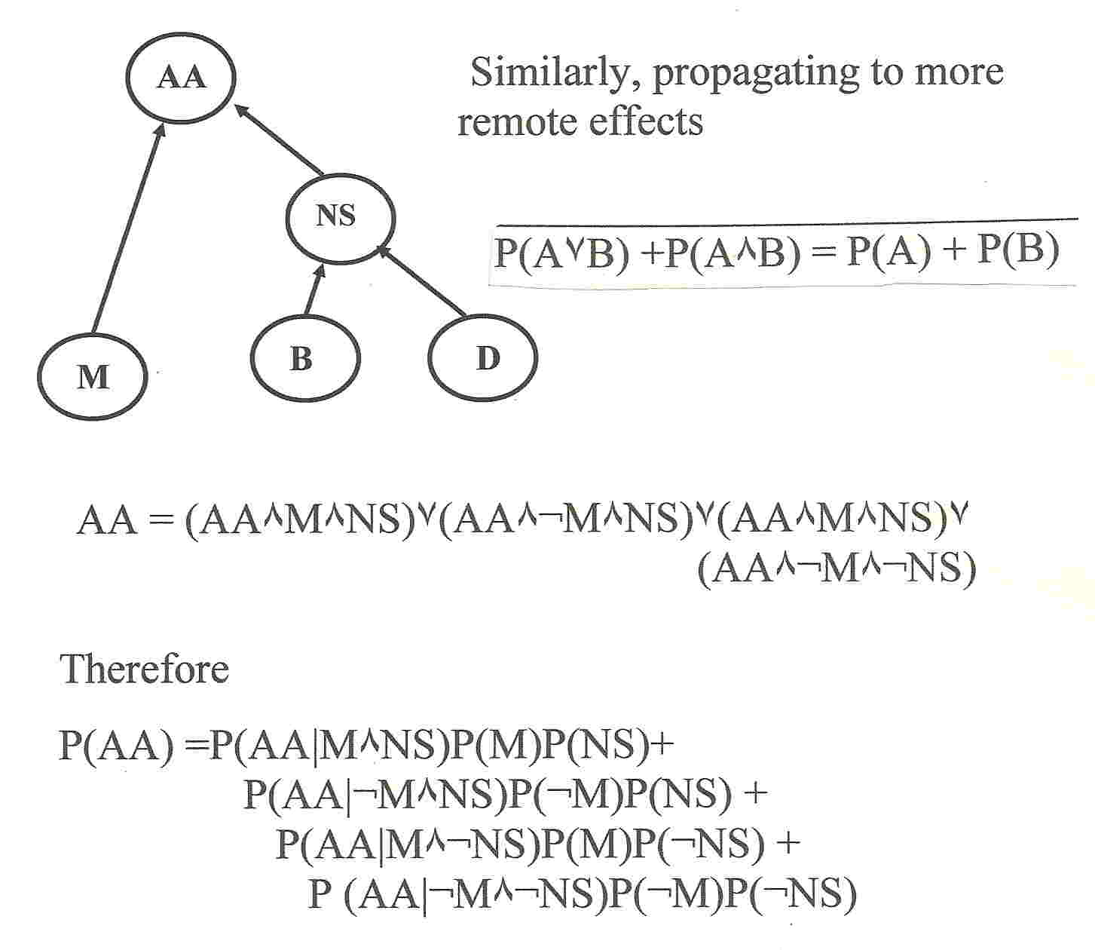
Extended causal propagation of belief

Slide 13
Why Diagnostic reasoning ?
When a top-level event has occurred, one often wants to know what contributed to its cause –
In the Auto example, if the AA were called, what is the likelihood that the caller was male
In a catastrophic rice of commodity prices, what is the probability that a harvest failed due to unusual weather in Brazil
Such knowledge is important in medicine and and maintenance of complex systems like nuclear reactors and and chemical plant

Slide 14
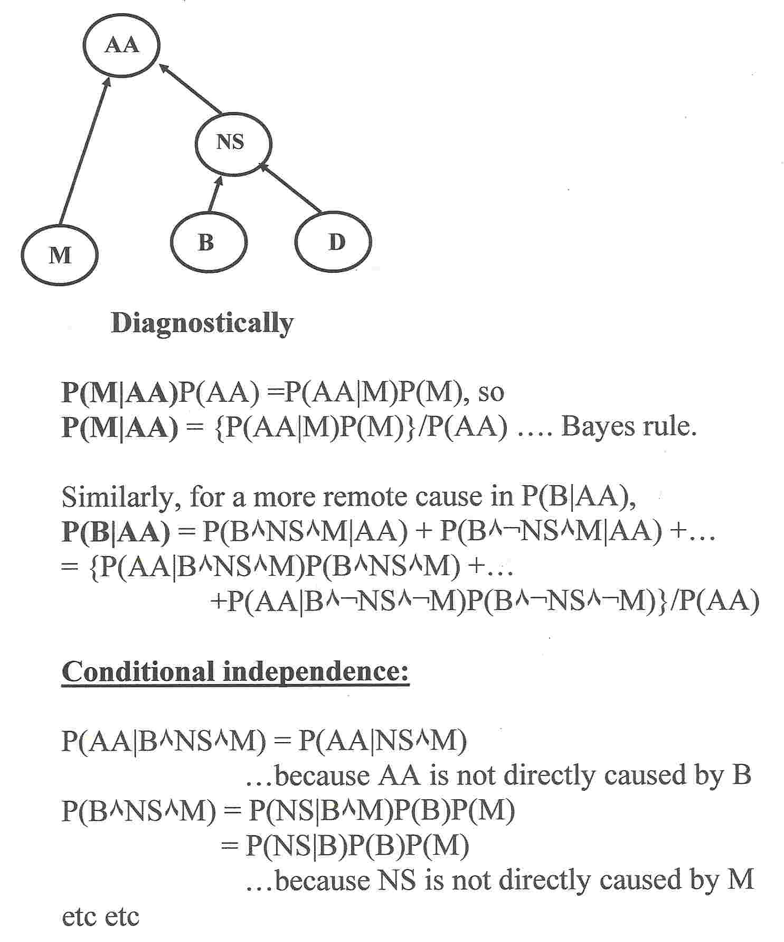
Diagnostic reasoning -computation

Slide 15
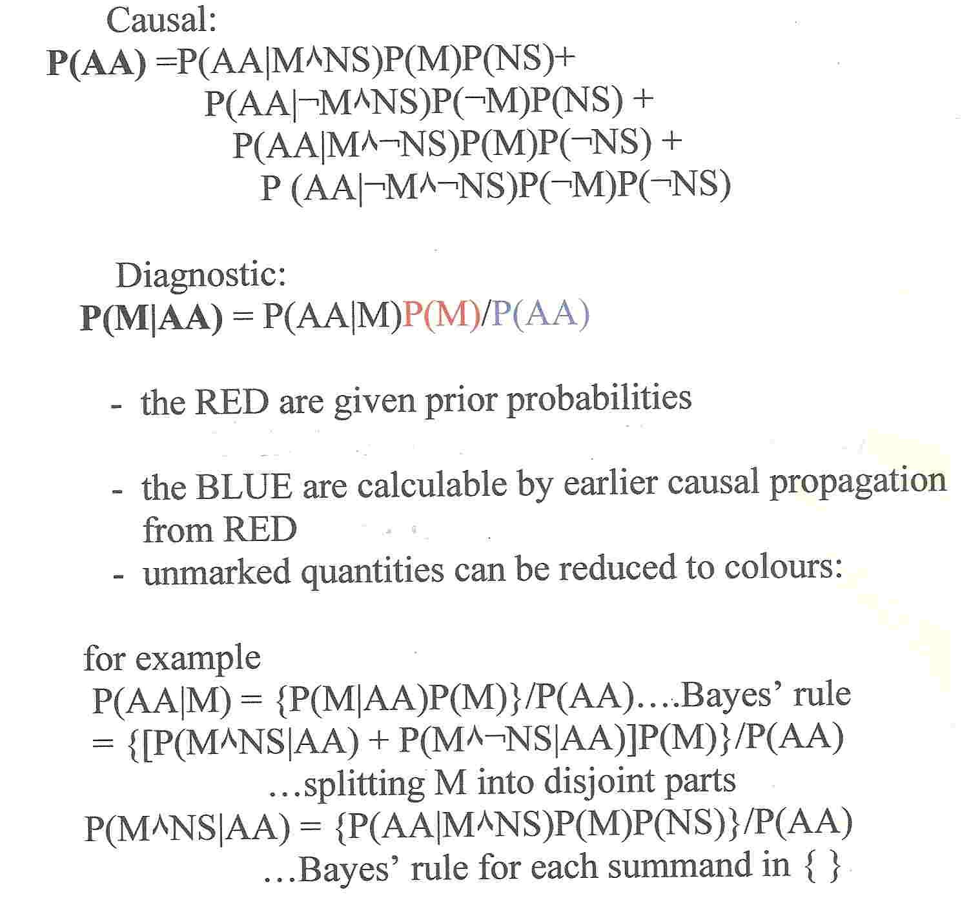
Computational load in complex nets

Slide 16
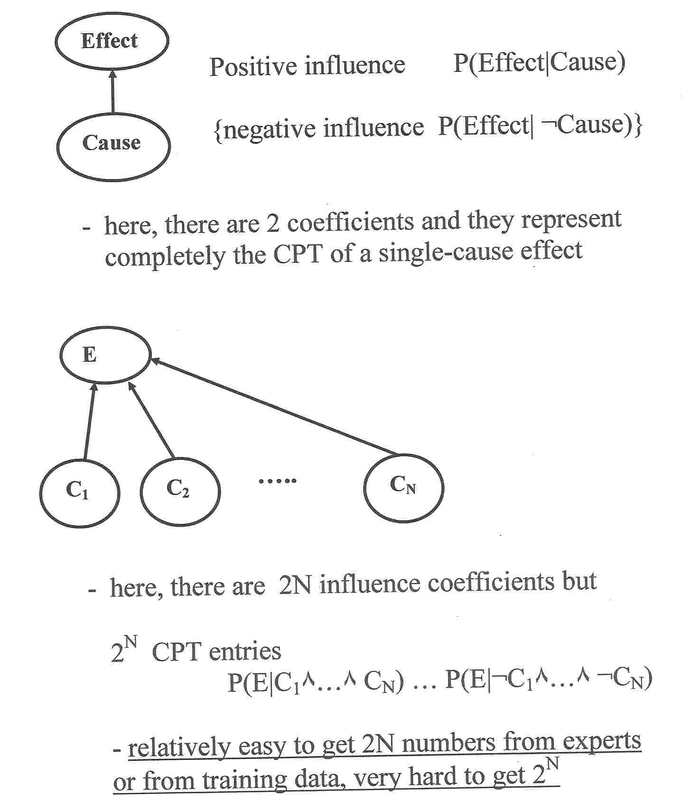
Influence coefficients – reducing complexity

Slide 17
Influence coefficients – an unproved conjecture
It has been speculated that a node with N causal feeds can be reduced to a group of equivalent nodes each with one feed
Of course each one-feed node is completely accounted for by two influence coefficients
The speculation amounts to claiming that all the computations in even a complex net can be made from influence coefficients
An eventual proof would take the form of induction on number N of feeds….but has not been completed
Nevertheless many users of Bayesian nets seek to ‘specify’ or ‘train’ them using only influence coefficients
A challenge for a keen young applied mathematician ??

Slide 18
That’s All Folks !
Reference: Ingleby, M & West MM, Causal Influence Coefficients: a Localised Entropy Approach to Bayesian Inference, in Mathematical and Statistical Methods in Reliability, Lindqvist & Doksum editors, World Scientific 2003.
email further questions to
inglebymeltham@btinternet.com
Carlile Institute, Meltham, W. Yorkshire

