Slide 1

Gender Equity as an Element of Education Quality: issues beyond access
Anjum Halai
Institute for Educational Development East Africa
Strathmore Conference
July 24, 2012

Slide 2
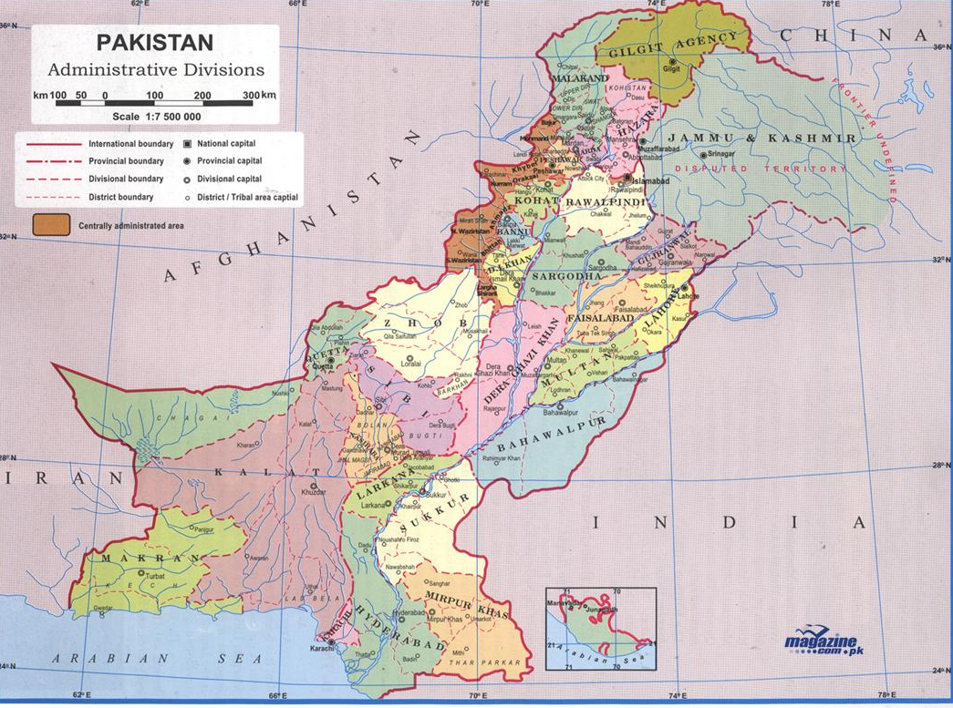

Slide 3
Context and Background
Pakistan is a highly gender segregated society and takes explicit account of gender in providing access to and administration of schooling.
43.8% govt primary schools are for boys, 31.5% govt primary schools for girls and the remaining 24.7%are schools with Mix enrolment.
The primary NER figures between 2000 and 2008 indicate that the NERs for girls are consistently lower than boys, indicating that in Pakistan girls have less access to primary education than boys.
Notes:
Female literacy rate shows an increasing trend, rising from 32.2% in 1999 to 44% in 2007-08. Likewise, for males the figure rose from 59.2% to 69%.

Slide 4
Contd: Context and Background
In rural Pakistan, 61% of teachers in primary schools are male.
Girls’ achievement in NEAS Examination taken at grade four (8–9 years) and again at grade eight (12–13 years), show that girls’ mean score is higher than boys at grade four level but is lower than boys at grade eight level.
On the NEAS exams, Boys did better on higher cognitive demand mathematics items as compared to girls (Tayyaba 2010)
Rural elementary schools are the main source of the gender gap in mathematics achievement due to inability of rural schools for girls to retain women teachers with adequate training in mathematics, and higher average level of education

Slide 5
Action Research
One Taluka in a rural district in Sindh Pakistan
14 secondary schools in the taluka (9 boys and 5 girls). 4 identified for inclusion in the action research project
12 teachers
Process of action and reflection over more than a year. Workshops, lesson observations, focus group discussion, interviews, teachers’ self inventory (gender)
Acknowledgement: EdQual www.edqual.org

Slide 6
Gender Equity and Social Justice in Education: Sen’s framework
Functioning is “the various things a person may value doing or being [---]
Capability is the alternative combinations of functioning that are feasible for a person to achieve
Freedom (well being and achievement)
Ref: (Sen 1999, p.75).

Slide 7
Gender awareness in schools and classrooms: case of a rural district in Pakistan
Disparity in teacher qualification and sense of efficacy in mathematics
  Teachers met the minimum criteria for secondary school teachers-but female teachers did not have mathematics as the major in under-graduate or graduate studies
  Male teachers maintained that they were proficient mathematically and needed to update their pedagogy
  Female teachers stated that they had not done much mathematics themselves and needed support in content knowledge development

Slide 8
Gender awareness in schools and classrooms: case of a rural district in Pakistan
Secondary schools in Taluka Mirpur Sakro: unequal access
  Accomodation of 8 girls in class IX & X in boys’ school
  DEO office maintained that this was not unusual but not documented in official records
  Upgradation of local girls primary school to the level of secondary school
  Unavailability of a secondary mathematics teacher

Slide 9
Gender awareness in schools and classrooms: case of a rural district in Pakistan
Teachers, learners and mathematics: gendered perspectives
  access to classrooms was seen as gender equity
  boys and girls have the same ‘‘natural ability’’ to learn mathematics
  mathematics was more useful for boys because they would develop their careers, whilst girls would be mainly homemakers and could use ‘‘hishab’’(arithmetic) in their household.

Slide 10
Conclusion I
Parents and community value education beyond primary school for girls. This has created a paradoxical situation where the community appears ready to challenge the deep rooted tradition of gender segregation in such key aspects of social life as schooling but the education bureaucracy is more conservative, insisting on single sex schooling and hence stretching its limited resources, with detrimental effect to the quality of schooling available to girls. Teachers, head teachers and the district education officials believed that equality in access to schools for boys and girls was equivalent to gender equity. The teachers’ reasoning process did not appear to go beyond access to the classrooms to consider ways in which they and in turn their students could realize their selfhoods and participate more fully in society. Their focus was on material resources required for teaching and learning but not on how social and cultural factors influenced learning and hence freedom to achieve in education.

Slide 11
Conclusion II
Beyond access, the schooling conditions were favourable for boys, especially in the case of mathematics teaching and learning. Girls’ freedom to learn was constrained relative to boys by their teachers’ inability to model a confident self-image as mathematicians. In addition, teachers’ expectations from girls as users of mathematics, was lower as compared to expectations from boys and reflected traditional societal perceptions of gender roles. Applying a capabilities lens, this can be understood as constraining girls’ aspirations and hence, curtailing girls’ ‘‘agency freedom’’ to choose success in mathematics as a valued goal.

Slide 12
Conclusion III
The extent to which access to education is turned into a capability with freedom to participate in ways that maximizes the potential for all learners, is a challenge for teacher preparation and teacher development. In the context of the highly gender segregated and traditional setting of Pakistan this would entail enhancing the professional capability of teachers to question some deep rooted social and cultural hierarchies embedded in gender relations, to recognise their influence on their own self-identity and on the opportunities for learning they provide for their students

Slide 13
References
EdQual (2011)
Halai, A. (2011) Equality or equity: Gender awareness issues in secondary schools in Pakistan. International Journal of Educational Development 31 44–49
Sen (1999). Development as Freedom. Oxford University Press, Oxford.
Tayyaba, S.(2010) Mathematics achievement in middle school level in Pakistan: Findings from the First National Assessment. International Journal of Educational Management, Vol. 24 Iss: 3 pp. 221 – 249 http://dx.doi.org/10.1108/09513541011031583
UNESCO (2010) Why Gender Equality in Basic Education in Pakistan. ISBN 978-969-8035-08-2 (Print version) ISBN 978-969-8035-09-9 (Electronic version)

