Slide 1
CENTRE FOR APPLIED RESEARCH IN MATHEMATICAL SCIENCES
International Mathematics Research Meeting, July 23-27, 2012
Strathmore University, Nairobi, KENYA
A Study on the Role of Reflection
in the Pedagogical Competence Development
of Zambian Mathematics Teachers
- Focusing on Qualitative Analysis Using Lesson Diary -
KINONE Chikara
Major in Development of Teaching Profession,
Graduate School of Education,
University of Miyazaki, JAPAN
E-Mail: ckinone@cc.miyazaki-u.ac.jp

Slide 2
Self-Introduction (on International cooperation)
2000-2002 | Japan Overseas Cooperation Volunteers (JOCV) for Dominican Republic (mathematics teacher)
2003-2005 | JOCV for Zambia (mathematics teacher)
2006-2008 | Japan International Cooperation Agency (JICA) “Project to Support the Operationalization of the In-Service Training Policy in the Republic of Ghana”
2008-2009 | JICA “Project for Strengthening the Child-Centered- Approach in the Union of Myanmar” (Phase Two)
2003-2006 2006-2012 | Master’s programme: Doctoral programme: Educational Development Course, Division of Educational Development and Cultural and Regional Studies, Graduate School for International Development and Cooperation (IDEC), Hiroshima University

Slide 3
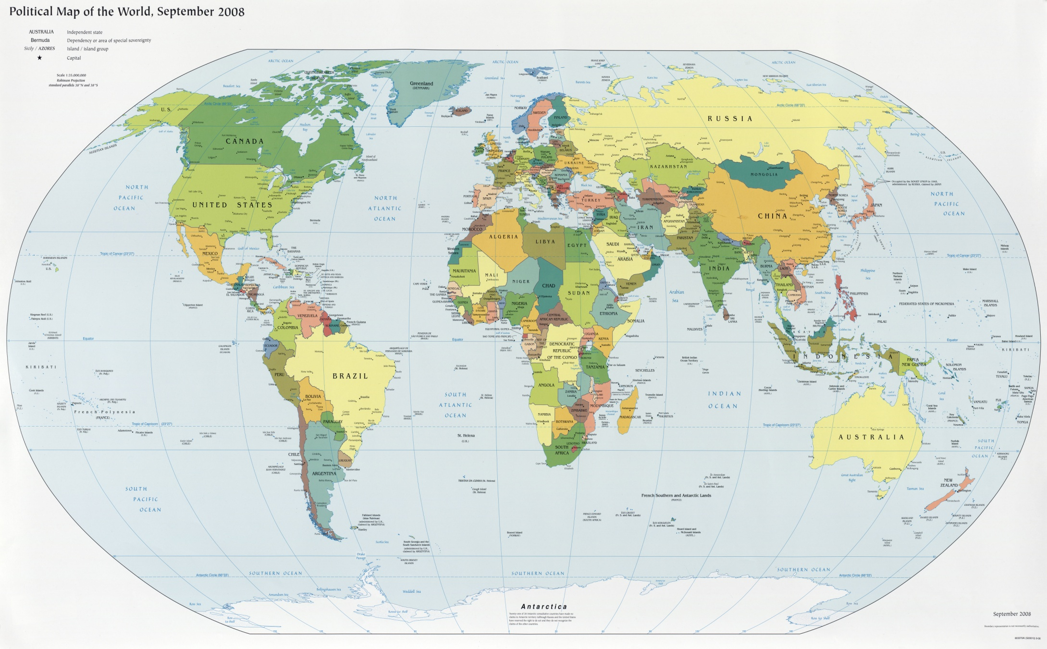
Japan
Dominican Republic
Ghana
Myanmar
Zambia
Kenya

Slide 4
Background (1)
A variety of international cooperation activities for educational development have been implemented since 1990 in the name of EFA and MDGs.
EFA-GMR2009 reported that “Many children attend primary school, and even graduate, without ever acquiring a minimum toolkit of literacy and numeracy skills.” (UNESCO, 2008, p.108)
Various issues on mathematics and science teachers in many countries (JICA, 2007):
Shortage of math & science teachers
Insufficient teacher education
Introduction of irrelevant teaching methods
Traditional lecture-style (knowledge-transfer) lesson

Slide 5
Background (2)
Initiatives and actions of teachers for their own educational improvement:
Educational issues should be found by teachers themselves.
Actions for the issues should be planned and implemented in consideration of their needs and social/cultural context.
Necessary competence for the actions should be developed based on their own practice.
↓↓↓
International cooperation should be reconsidered as a support for these problem solving and competence development (as “endogenous approach”).
The focus of this research is on teachers’ “Reflection” on their mathematics lessons.

Slide 6
Objectives of this research
To identify the current status of Zambian teachers’ reflection on their own mathematics lessons, the change of their reflection, and the role of their reflection in their pedagogical competence development by qualitative data analysis based on their writing in “Lesson Diary”.

Slide 7
Country involved in this research
Republic of Zambia:
“School Programme of In-service for the Term (SPRINT)” focusing on teachers’ reflection and collegiality has been running since 1999.
International cooperation projects for Zambian teacher education have been implemented by Belgium, USA, Japan, etc. based on SPRINT.
↓↓↓
There would be a possibility to have suggestions toward international cooperation for mathematics teacher education as endogenous approach.

Slide 8
Intended mathematics curriculum in Zambia (1)
It aims at enabling students acquire:
Mathematical knowledge and skills necessary for application in their daily lives
Numeracy
Communication of mathematical ideas among learners
Problem solving
Application to real life situations
Interest in mathematics
Social skills and attitudes (confidence, commitment, motivation)
Curriculum Development Centre (2003) Zambia Basic Education Syllabi Grade 1-7. Ministry of Education, Lusaka, Zambia.

Slide 9
Intended mathematics curriculum in Zambia (2)
Teachers are expected to use a variety of approaches for teaching:
Learner-centred approach
Activity-based approach
Participatory approach
Context based approach
(including problem solving, group work, role-play, fieldwork, case study and project work)
Curriculum Development Centre (2003) Zambia Basic Education Syllabi Grade 1-7. Ministry of Education, Lusaka, Zambia.

Slide 10
Framework for Analysis on Mathematics Teachers’ Reflection
Aspect (1) : “Content” of reflection
Manouchehri(2002)
“Foci of attention”
UNESCO(2004)
“Context” in “a framework for understanding education quality”
Ina et.al.(2003)
“Contextual Framework” (TIMSS)

Slide 11
 |  | Manouchehri(2002) “fosi of attention” | UNESCO(2004) “Context” in “a framework for understanding education quality” | Ina et.al(2003) “Contextual Framework”
Teaching content/ Mathematics |  | Mathematics
Learners/ Learning activity |  | Learners’ actions and understandings, Activity/task, Assignments, Learner’s background |  | Prior Experiences, Attitudes
Teachers/ Teaching activity |  | Self, Teacher’s actions |  | Academic Preparation and Certification, Teacher Assignment, Teacher Experience, Teaching Styles, Professional Development, Curriculum Topics Taught, Time, Homework, Assessment
Classroom/ School |  | Management/control, School culture | Peer effects | Classroom Climate, Disciplined School Environment, Information Technology, Calculator Use, Emphasis on Investigations, Class Size, School Organization, School Goals, Roles of the School Principal, Resources to Support Mathematics and Science Learning
Social/cultural Context | Parents/ home |  | Parental support, Time available for schooling and homework | Home Background, Parental Involvement
 | Community |  | Economic and labour market conditions in the community, Socio-cultural and religious factors, Competitiveness of the teaching profession on the labour market, Philosophical standpoint of teacher and learner, Labour market demands
 | Government/ Educational administration | Curriculum | Educational knowledge and support infrastructure, Public resources available for education, National governance and management strategies, National standards, Public expectations | Teacher Recruitment, Teacher Induction, Formulating the Curriculum, Scope and Content of the Curriculum, Organization of the Curriculum, Monitoring and Evaluating the Implemented Curriculum, Curricular Materials and Support
 | International Society |  | Aid strategies, Globalization
Framework on “Content” of reflection

Slide 12
Framework for Analysis on Mathematics Teachers’ Reflection
Aspect (2) : “Process” of reflection
McDuffie(2004)：
“Reflective cycle” (problematizing, analysing, planning, implementing and testing)
Jansen & Spitzer(2009), van Es & Sherin(2008)：
Rodgers(2002)’s “Reflective cycle” (presence in experience, description of experience, analysis of experience, experimentation)
Korthagen(1985, 2001) ：
“ALACT model” (action, looking back on the action, awareness of essential aspects, creating alternative methods of action, trial)

Slide 13
 | Action (1) | Reflection on Action | Action (2)
McDuffie |  | problematizing | analysing | planning | implementing and testing
Jansen & Spitzer van Es & Sherin | presence in experience | description of experience | analysis of experience |  | experimentation
Korthagen | action | looking back on the action | awareness of essential aspects | creating alternative methods of action | trial
Framework on
“Process” of reflection

Slide 14
Framework for Analysis on Mathematics Teachers’ Reflection
Aspect (3) : “Level” of reflection
Manouchehri(2002) “Level of reflection”
Level of reflection | description
Describing | Story telling Recall of classroom events
Explaining | Connecting interrelated events Exploring cause and effect issues related to teaching/learning actions
Theorizing | An explanation of how one knows what she knows References to research on learning and teaching Reference to past experiences References to past course work and reading
Confronting | Search for finding alternative theories to explain events and actions The individual challenges her own views and what she knows in the process of search
Restructuring | Revisiting the event with the intent to re-organize teaching actions and/or curricular choices
Framework on
“Level” of reflection
(referring based on the current status of teacher’s reflection)

Slide 15
Framework for Analysis on Teacher’s Reflection
 |  | Content
 |  | Teaching content/ mathematics | Learner | Teacher | Classroom/School | Social/Cultural Context
 |  |  |  |  |  | Parents/ home | Community | Government/Educational administration | International Society
Process | Looking back on the action
 | Awareness of essential aspects
 | Creating alternative methods of action
Level

Slide 16
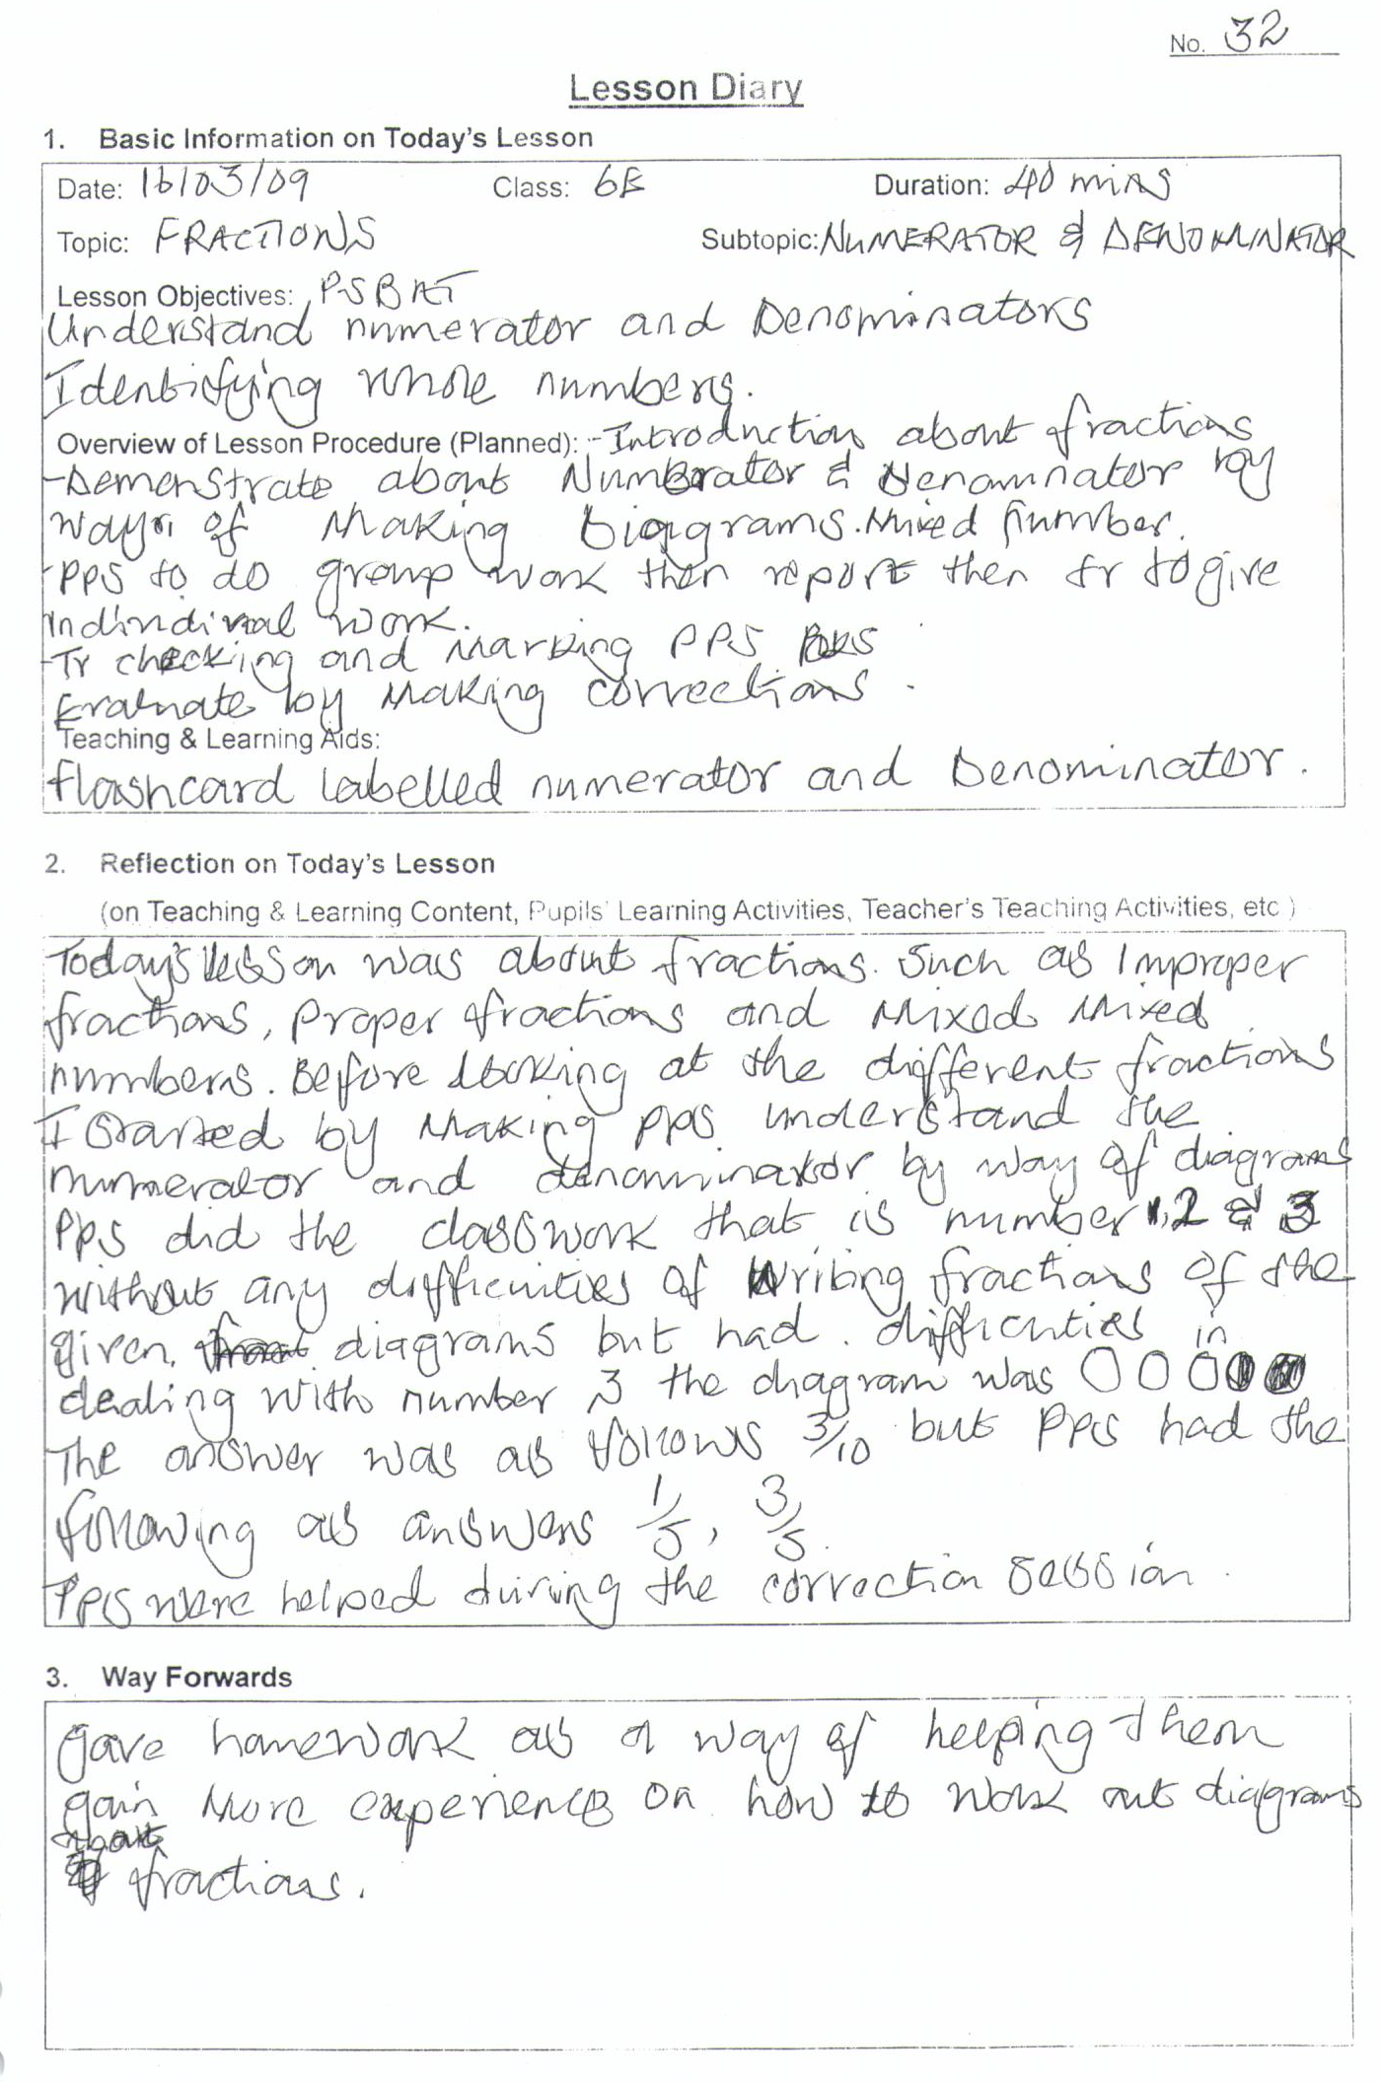
“Lesson Diary for Mathematics Classes”
1. Basic information on Today’s Lesson:
Indicating date, class, duration, topic, objectives, procedure, teaching and learning aids
2. Reflection on Today’s Lesson:
Indicating teacher’s reflections: teaching activity, learning activity, teaching contents, etc.
3. Way Forwards:
Indicating issues and actions what teacher want to take based on their reflections

Slide 17
Qualitative Data Analysis (Sato, 2008)
Steps：
Transcribing teachers’ writings and statements in interviews as textual data
Segmentalizing and summarizing the textual data
Qualitative coding based on the textual segments and summaries
Analysing by continuous comparison with case-code matrix
Referring the results of field works (questionnaire, lesson observation, field notes, textbooks, etc.)

Slide 18
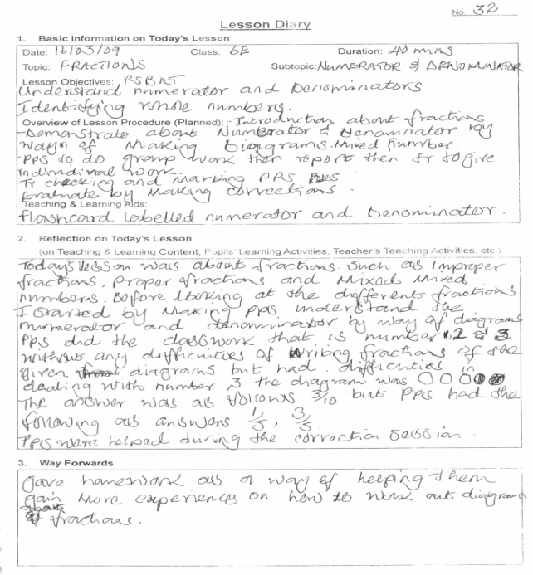
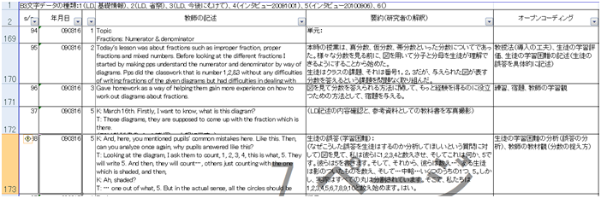
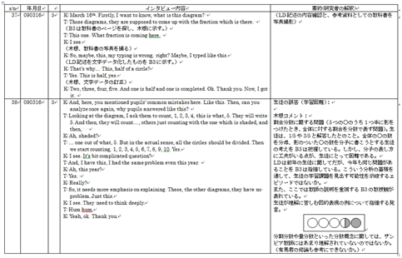
Lesson Diary (teacher’s writing)
Textual data/segments (Excel sheet)
Translating teachers’ writings and statements as textual data
Teacher’s statements in interview on Lesson Diary

Slide 19
Summary on textual segments (researcher’s interpretation)
Open-coding
based on summaries
Summaries and open-coding of textual segments (Excel sheet)

Slide 20
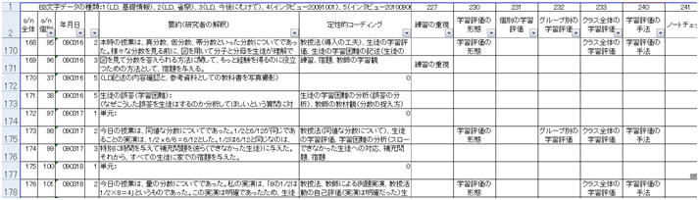
textual segments, summaries, open-coding (Excel Sheet)
Focused coding (Excel Sheet)
Focused coding through comparing between textual segments and open-coding

Slide 21
Teachers involved in this research
 | Young teacher | Experienced teacher
“R” school in a rural area | Mrs. Banda 31 years old TE: 2 years and 4 months Grade 3 | Mrs. Zulu 42 years old TE: 14 years and 6 months Grade 1
“U” school in an urban area | Mrs. Kunda 26 years old TE: 3 years Grade 6 | Mrs. Mulenga 47 years old TE: 22 years Grade 7
TE: Teaching experience

Slide 22
Data collected from teachers
School | Teacher | Lesson Diary | Interview | Lesson observation | Questionnaire
“R” school in a rural area | Mrs. Banda | 35 lessons | 25/09/2009 07/09/2010 | 4 lessons | Nov. 2008
 | Mrs. Zulu | 51 lessons | 25/09/2009 03/09/2010 | 4 lessons | Nov. 2008
“U” school in an urban area | Mrs. Kunda | 59 lessons | 01/10/2009 06/09/2010 | 2 lessons | Nov. 2008
 | Mrs. Mulenga | 34 lessons | 29/09/2009 06/09/2010 | 2 lessons | Nov. 2008

Slide 23
Mrs. Banda (“R” school in a rural area)
(1) Teaching content/mathematics
  Strong sense of procedural understanding
  I had introduced them multiplication table. Yes. That table what I did was at…, it was on the chart. I just told them. I just, I put it on the…, on the board, the chart. The…, I just wanted them to know how to multiply using the multiplication… [partially omitted] …So, now the confusion is, like, like addition they know that could be kept up for you add on. Subtraction, you, you subtract, maybe you remove. They know that they understand those contents. And division is like, it just going something, something like that. Now multiplication is very difficult for them to realize that this is just to come three times or twice. Something like that. So, some…, it was difficult for them. Some was subtracting, some was…, just like that.
  (statement 07/09/’10: on lesson diary 25/06/’09)

Slide 24
Mrs. Banda (“R” school in a rural area)
Teaching content/mathematics
  Considering students, while following textbook
  Maybe, if you find that, like even if you find that they don’t understand, I have to, at least, change (and) find some simpler ways. Because what we do sometimes is…, we do simplify. You find that they are not able, like, this way, like, if you look at this, they are not, you find that it’s difficult for them to understand on this words. Maybe you just consult on this. Yes. This should be on its on now. So long they understand that one is the thousands, they know the thousand, hundred, tens and ones. That’s what we do. Because sometimes, if you look at the, where…, the books, the syllabus where they are…, you know… It’s difficult if you just follow that they will not understand anything. So we find ways that simpler ways that they can understand. You simplify as a teacher before you go in the class. Because, if you just pick it exactly, so they will fail.
  (statement 07/09/’10: on lesson diary 23/02/’09)

Slide 25
Mrs. Banda (“R” school in a rural area)
(2) Learner/learning activity
  Superficial description on students’ learning
  The lesson was taught successfully as the pupils were able to do the exercise correctly.
  (lesson diary 23/06/’09)
  Concrete description on students’ learning
  The lesson was taught but not successfully because pupils were not able to identify place values. Not able to count in Thousands, Hundreds, Tens and Ones, however the lesson to be repeated.
  (lesson diary 27/01/’09)
  ↓↓↓
  Attaching importance to “knowledge” and “skills”

Slide 26
Mrs. Banda (“R” school in a rural area)
(3) Teacher/teaching activity
  Efficient “knowledge-transfer” teaching considering “simplicity” and “concreteness”
  You don’t use maybe long methods (like textbook). This is just straight forward. Three into three is one. Three into six, it is two. Three into three, it is one. That’s so. There, it becomes easier. Because even if you are use…, using like…, long division. They, they, they, could get confused down. But here, on top, they are able to find the answer. So, like they, who are used, maybe, it was a bit… tricky for them. But this method was…, because they, they were used to this method.
  (statement 07/09/’10: on lesson diary 02/07/’09)

Slide 27
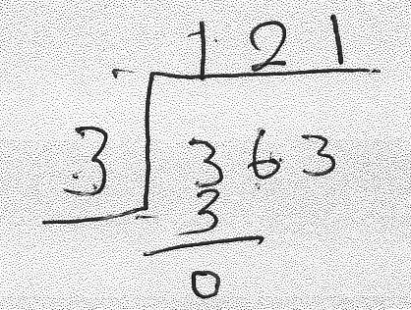
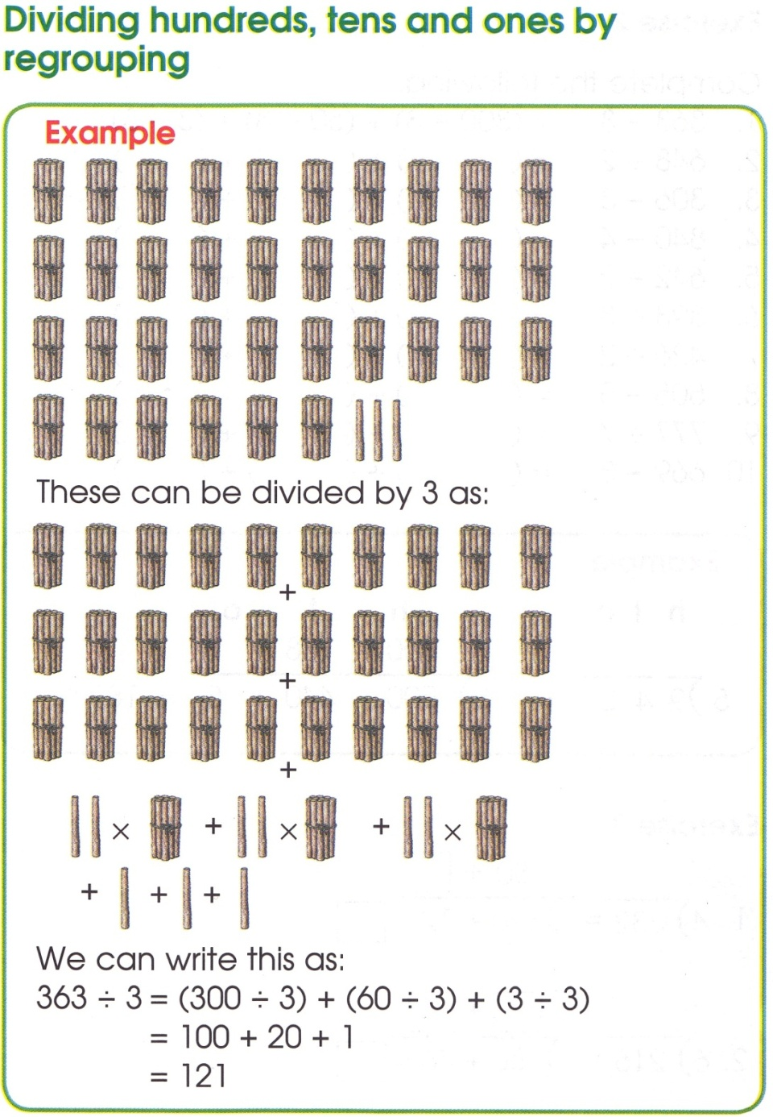
Division 363÷3
Mrs. Banda’s memo
Division 363÷3
Explanation of textbook
Procedure of calculation
3 groups of “one hundred”
Pictorial representation
Meaning of calculation
3 groups of “two tens (twenty)”
3 groups of “One”
Symbolical (mathematical) representation

Slide 28
Mrs. Banda (“R” school in a rural area)
(4) Classroom/School
  School’s financial situation
  (lack of teaching/ learning aids, etc.)
  There are some improvements, although there, the other disappointment is… Sometimes, even material. You know, in this school, maybe a teacher would like to teach, but sometimes, you, you find that you are lacking materials. Because, even in CPD, sometimes…, you can go on, but you know, you maybe just discuss, go on discussing, but you know that you are, you are supposed to have this, but you don’t have that.
  (statement 25/09/’09)

Slide 29
Mrs. Banda (“R” school in a rural area)
(5) Social/Cultural Context
  Environment of rural area
  (lack of learning condition for students)
  And you know, town is different from that area. The foundations are not … good. Yes. These… start from…, going up…, and their understanding is different. Now those from rural area is, you know, just from home someone comes to school, their level is…
  (statement 07/09/’10: on lesson diary 04/03/’09)

Slide 30
Model of Mrs. Banda’s reflection
Perspective of mathematics education
Teaching content/
mathematics
  Strong sense of procedural understanding
  Considering students, while following textbook
Learner/learning
  Attaching importance to “knowledge” and “skills”
Teacher/teaching
  Efficient “knowledge-transfer” teaching considering “simplicity” and “concreteness”
Context of mathematics teaching
Classroom/school
  School’s financial condition (lack of teaching/ learning aids, etc.)
Social/cultural context
  Environment of rural area (lack of learning condition for students)

Slide 31
Evaluation
  Viewpoint: “What did they do?” “What didn’t they do?”
Focus: On whole class
Level: Superficial description, concrete description
Looking back on the action
“3/4 of students understood.”
“1/2 of students understood.”
“3/4 of students didn’t understand.”
“Lesson was successful.”
“Lesson was not successful.”
Awareness of essential aspects
Analysis of teaching
  Simplicity
Concreteness
Lack of teaching/learning aids
Factors of students’
low achievement
  Slow learner
Living in rural area
Creating alternative methods of action
Lesson Improvement
  Teaching methods
Teaching/learning aids
Example
Setting of numbers in question
Giving extra work
Go to next lesson.
Support for students
who did not understand
  Giving extra work

Slide 32
Case-Code Matrix: “Contents” of Reflection
 | Mrs.Banda (rural: young) | Mrs. Zulu (rural: experienced) | Mrs. Kunda (urban: young) | Mrs. Mulenga (urban: experienced)
Teaching content /Mathematics | Attaches importance to procedural understanding more than understanding on the meaning of knowledge. Basically follows textbooks., but sometimes, arranges teaching content considering students. | Attaches importance to availability of mathematical knowledge in daily life. Attaches importance to textbook explaining in detail. Considers students. | Tr’s understanding of mathematics is not enough. Tends to depend on textbooks strongly. | Thinks that mathematics is available in daily life, interesting and a fun. Has a perspective that mathematics is ready-made, and memorizing formulas is important. Pays a lot of attention to examination.
Learner/ Learning activity | Recognizes mathematics learning as acquiring knowledge and mastering skills. Evaluates students’ learning with superficial and concrete descriptions. | Expects students to understand the meaning of content, to master formulas and to apply in daily life. Attaches importance to learning with operational activity and exercises. Evaluates students’ learning not only as a whole class, also small groups or individual. And evaluates with concrete and analytical descriptions. | Expects students to understand content exactly, use it and apply it in daily life. Has strong perspective of mathematics learning as memorization fundamentally, and attaches importance to the proficiency of knowledge. Tries to capture students’ learning difficulty to some extent. | Tries to make students use knowledge and skills by applying in daily life, and expects to pass examination. Analyzes learning difficulty with the viewpoints on examples of incorrect answers, students’ minds, following teacher’s instruction, slow learners, etc. and pays attention to the influence of home and learning experience.
Teacher/ Teaching activity | Has a consciousness of efficient knowledge-transfer style with the consideration of simplicity and concreteness in teaching mathematics. Has less consciousness about understanding on meaning of mathematical knowledge. | Has a perspective of considering concreteness and students’ status. Main activities are Tr’s demonstration, exercise, teaching/learning aids, various representations. Evaluates lessons by checking if ¾ understand, and attaches importance to support of students who didn’t understand. | Has traditional teaching perspective. Thinks that examples are important. Recognizes learner-centered lesson as group work. | Thinks that connection to daily life, considering students’ status, simplicity of explanation are important. Main teaching activities are Tr’s demonstration and exercise. Repeats same lesson if it was not good.
Classroom/ school | Thinks that it is difficult to conduct intended lessons due to school’s severe financial condition. | Discusses with colleagues about lesson practices and teaching methods. | Thinks that school’s severe financial condition influences lesson practices and trs’ pedagogical competence development negatively. | Thinks that it is difficult to implement planned lessons due to school activities and organizational matter.
Social/cultural context | Thinks that students in rural area don’t have good conditions for learning, and such condition influences school leaning negatively. | Thinks that parents’ consideration influences students’ school life. Tends to relate students’ difficulties to pre-school education. | Has a strong consciousness of national exam at grade 7. | Thinks that national exam, promotion system, teachers’ strike, educational administration, parents’ influence, pre-school education, home environment, etc. give a lot of influence to students’ learning and mathematics lessons.

Slide 33
Case-Code Matrix: “Process” of Reflection
 | Mrs.Banda (rural: young) | Mrs. Zulu (rural: experienced) | Mrs. Kunda (urban: young) | Mrs. Mulenga (urban: experienced)
Looking back on the action | Evaluation Viewpoint: “What did they do?” “What didn’t they do?” Focus: On whole class Level: Superficial description, concrete description | Evaluation Viewpoint: “What did they do?” “What didn’t they do?” “Why didn’t they do?” Focus: On individual, groups and whole class Level: Superficial description, concrete description, analytical description | Evaluation Viewpoint: “What didn’t they do?” Focus: On whole class Level: Concrete description | Evaluation Viewpoint: “Did they do exercises given in lesson Focus: On whole class Level: Superficial description, concrete description, analytical description
 | “Did ¾ understand or not?” | “Did ¾ understand or not?” | “Did ¾ understand or not?” | “Did ¾ understand or not?”
 | Judge of lesson (good or not good) | Judge of lesson (good or not good) |  | Judge of lesson (good or not good)
 |  | Support for students who didn’t understand
Awareness of essential aspects | Factors of students’ learning difficulty Slow learner Living in rural area | Factors of students’ learning difficulty School life Students’ mind Disability Home Parents’ attitude/consideration Pre-school education Students’ misunderstanding | Factors of students’ learning difficulty Slow learner Students’ mind (carelessness, lack of exercise ) | Factors of students’ learning difficulty misunderstanding Students’ mind Attention to Tr’s instruction Slow learner
 | Analysis of teaching activity Simplicity Concreteness Lack of teaching/learning aids | Analysis of teaching activity Study on teaching methods based on teaching experience Study on teaching content using textbooks and teacher’s guides Discussion with colleagues
Creating alternative methods of action | Lesson improvement Teaching methods Teaching/learning aids Example Setting of numbers in question Giving extra work | Lesson improvement Grouping (whole class, group, individual) exercise Teaching/learning aids Overcome of learning difficulty Teaching method Repetition of lesson Revision |  | Repetition of lesson Tr’s demonstration of example Exercise
 | Support to students who didn’t do Giving exercise | Support to students who didn’t do Remedial work, individual teaching Giving exercise | Support to students who didn’t do Giving exercise

Slide 34
Discussion (1)
Similarity: “Content” of reflection
Teaching content/mathematics：
application of mathematics in daily life; “ready-made” mathematics; following textbooks
Learner/learning activity：
Memorization-based learning; learning for application in daily life; superficial/ concrete evaluation (less analytical evaluation)
Teacher/teaching activity：
Efficient “knowledge-transfer” teaching; checking whether ¾ of student understood the lesson
Classroom/school：
Lack of teaching/learning aids

Slide 35
Discussion (2)
Similarity: “Process” of reflection
Looking back on the action：
What did/didn’t students learn?
Did ¾ of students understand the lesson?
Awareness of essential aspects：
Recognizing those who didn’t understand as “slow learners”.
Creating alternative methods of action：
Giving extra work to students who didn’t understand.

Slide 36
Discussion (3)
Difference: “Content” of reflection (1)
Teaching contents/mathematics：
Teachers in rural area have more consciousness of students’ low understanding.
Learner/learning activity：
Experienced teachers evaluate students’ learning with more analytical descriptions based on their rich teaching experience.
Especially, Mrs. Mulenga (grade 7) has more consciousness of the influences students’ learning experiences.
Teacher/teaching activity：
Young teachers have knowledge on new teaching methods, but cannot utilize it in their mathematics lessons.
Experienced teachers implement lessons considering students’ current status/understanding.

Slide 37
Discussion (4)
Difference: “Content” of reflection (2)
Classroom/school：
Young teachers tend to have a consciousness of severe school financial condition.
Experienced teachers tend to pay attention to school’s organizational aspects (collegiality, teacher organization, lesson planning).
Social/cultural context：
Teachers in rural area have consciousness about the influence of rural environment to students’ learning.

Slide 38
Discussion (5)
Difference: “Process” of reflection
Looking back on the action：
Experienced teachers tend to evaluate students’ learning with analytical descriptions.
Awareness of essential aspects：
Experienced teachers have more viewpoints for analyzing students’ learning difficulties than young teachers.
Teachers in rural area tend to analyze their own teaching more than teachers in urban area.
Creating alternative methods of action：
Teachers in rural area tend to have more ideas for improving their mathematics lessons.

Slide 39
Discussion (6)
Unconscious matters
Teachers don’t analyze successful mathematics lessons (Why lessons were successful? What were the factors for that?).
Teachers don’t mention about Zambian intended mathematics curriculum.
Teachers don’t reflect concretely on their own teaching activities (for example, use of black board, teacher’s statements and questions in lessons, interactions between teacher and students or among students, etc.).

Slide 40
Conclusion (1)
Common characteristics of the teachers’ reflections：
The focus of their reflection is on how to transfer mathematical knowledge and formulas efficiently and give exercises effectively in order for students to memorize and use them. This is based on traditional perspective of mathematics education (knowledge-transfer style).
They reflect only on unsuccessful lessons, not on successful ones. Therefore, they don’t gather knowledge and insights from good lessons.
They tend to be conscious of textbooks and students, rather than intended curriculum.

Slide 41
Conclusion (2)
Characteristics of young teachers’ reflection:
Although they have viewpoints of recent mathematics education in terms of student’s understanding and teaching methods for mathematics. However, they cannot realize these viewpoints in their lesson practices.
The focus tends to be on school’s financial condition.
Characteristics of experienced teachers’ reflection:
The focus is on the current status of students’ understanding and affective aspects, although their teaching perspective is traditional knowledge-transfer style.
They are more conscious of analytical evaluation of students’ learning.
They have more viewpoints on the factors of students’ learning difficulty and teaching practices.

Slide 42
Conclusion (3)
Characteristics of reflection of teachers in rural area:
They tend to think about the influence of rural environment upon students’ learning.
They tend to study teaching content, look back to lesson, and think about lesson improvement in consideration of current status of students.
Characteristics of reflection of teachers in urban area:
They tend to consider national examination strongly.

Slide 43
Conclusion (4)
Roles of reflection in their pedagogical competence development:
Their reflections play a role to check whether teachers give students mathematical knowledge and exercises efficiently on the basis of the traditional perspective of mathematics education as “knowledge-transfer” style.
↓↓↓
It is necessary to find a way that educational staff concerned (school teachers, researchers and teacher educators of university/teacher training college, regional education office, and ministry of education) collaborate in order to gather and share practical experiences of realizing the intended curriculum, and to implement professional supports.

Slide 44
Further works (1)
International Research on the Formation of Teachers’ “Community of Practice” and their “Identity” in Mathematics and Science Education
Objectives:
To describe the process of the formation of teachers’ community of practice and their identity for the development of mathematics and science education in African and Asian countries
Target Countries:
Kenya, Zambia, Bangladesh and Cambodia

Slide 45
Further works (2)
International Research on the Formation of Teachers’ “Community of Practice” and their “Identity” in Mathematics and Science Education
Research Activities:
To study teacher education system for mathematics and science teachers
To analyze the growth of individual teacher and the formation of teachers’ community of practice (as professional group)
To identify the interrelation between the teacher education system, the individual growth, and the formation of teachers’ community and their identity

Slide 46
Reference:
国際協力機構(2007)『JICA理数科教育協力にかかる事業経験体系化～その理念とアプローチ～』, 国際協力機構, 国際協力総合研修所.
佐藤郁哉(2008)『質的データ分析法 原理・方法・実践』新曜社.
Curriculum Development Centre (2003) Zambia Basic Education Syllabi Grade 1-7. Ministry of Education, Lusaka, Zambia.
Ina, V. S. M., Michael, O. M., Teresa, A. S., Robert, A. G., Kelvin, D. G., Eugenio, J. G., Steven, J. C. and Kathleen, M. O. (2003) Assessment Frameworks and Specifications 2003 2nd edition. The International Association for the Evaluation of Educational Achievement.
Jansen, A. and Spitzer, S. M. (2009) “Prospective middle school mathematics teachers’ reflective thinking skills: descriptions of their students’ thinking and interpretations of their teaching.” Journal of Mathematics Teacher Education 12, pp.133-151.
Korthagen, F. A. J. (1985) “Reflective Teaching and Preservice Teacher Education in the Netherlands.” Journal of Teacher Education 36(5), pp.11-15.
Korthagen, F. A. J. (2001) Linking Practice and Theory: The Pedagogy of Realistic Teacher Education. Lawrence Erlbaum Associates.
Manouchehri, A. (2002) “Developing teaching knowledge through peer discourse.” Teaching and Teacher Education, 18, pp.715-737.
McDuffie, A. R. (2004) “Mathematics Teaching as a Deliberate Practice: An Investigation of Elementary Pre-service Teachers' Reflective Thinking During Student Teaching.” Journal of Mathematics Teacher Education 7(1), pp.33-61.
Rodgers, C. R. (2002) “Seeing student learning: Teacher change and the role of reflection.” Harvard Educational Review, 72(2), pp.230-253.
UNESCO (2004) EFA Global Monitoring Report 2005 Education for All The Quality Imperative. UNESCO Publishing, Paris.
UNESCO (2008) EFA Global Monitoring Report 2009 Education for All Overcoming Inequality: Why Governance Matters. UNESCO Publishing, Paris.
van Es, E. A. and Sherin, M. G. (2008) “Mathematics teachers’ “learning to notice” in the context of a video club.” Teaching and Teacher Education, 24(2), pp.244-276.

Slide 47
Thank you for your attention.

